Slide 1


2020/21 Recruitment Analysis & Competitor Insights
Data Science Group
Christian Gilson
{firstname}@manutd.co.uk
Notes:
Day job: head up a data science team focused on feature engineering at quant hedge fund Two Sigma
Spare time: enjoy applying the techniques from quant finance to quant football.
My project developed techniques and software to support systematic player recruitment and competitor analysis
* I open-sourced the software for practitioners to use;
* Giving this presentation from practitioner's perspective at a professional football club
Structure:
* Motivation;
* Data;
* Models built;
* Applications resulting from those models.
* References are provided in the appendix.

Slide 2

Motivation
Systematic, data-driven approach to player recruitment:
Identify high and poor performing players within squad;
Identify transfer targets enabling Man United to:
Mitigate key asset losses;
Strengthen positions of vulnerability.
Identify opponent strengths & weaknesses to inform matchday strategy.
Notes:
Two motivations:
At the player-level...
At the team-level...

Slide 3
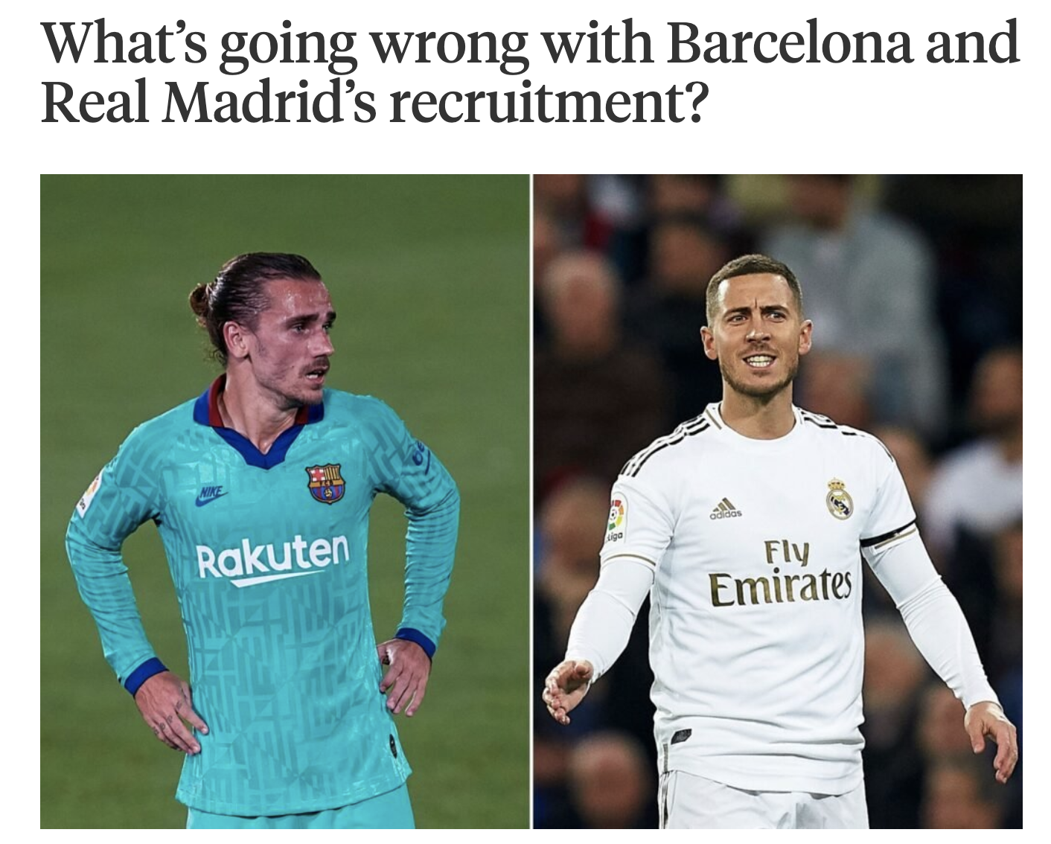
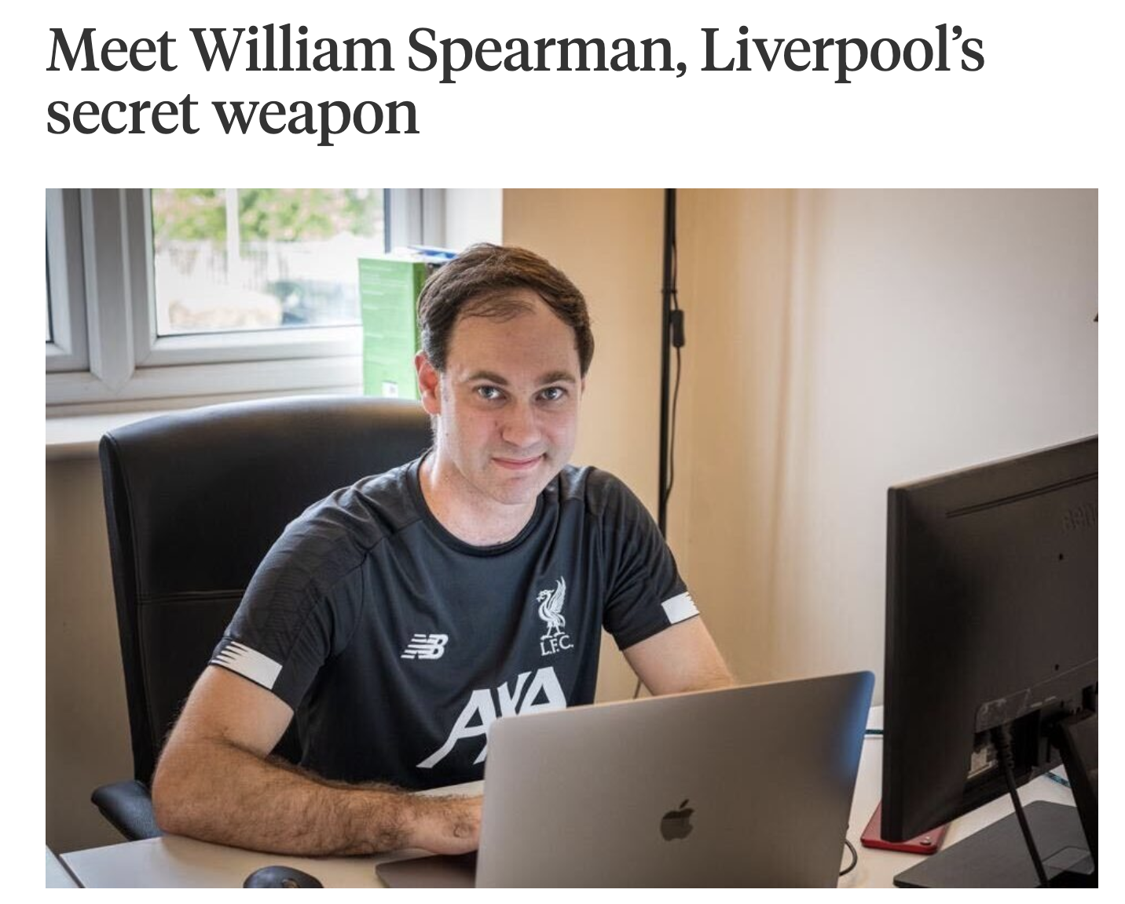
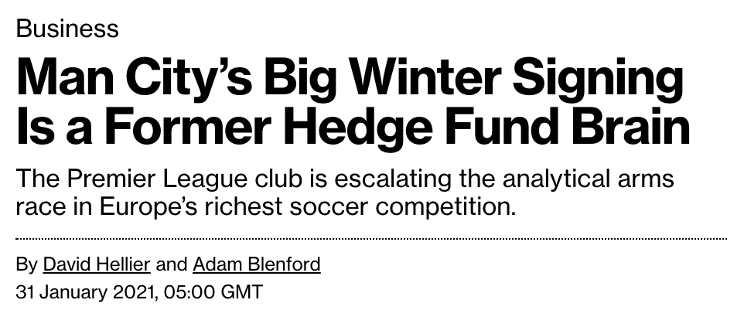
Competition: on and off the pitch
Since 2014, Barcelona’s net spend of €450m is 3x that of 18/19 Champions League winners Liverpool.
Hard to find competitive edge in data-driven football recruitment: complex invasion game with game-changing actions happening off the ball.
Traditionally, only 0.25% of all actions have been used to quantitatively measure output: goals and assists.
We built two complementary models to value offensive actions: every pass, cross, dribble and shot.
Notes:
Applying data science to football is competitive!
Nearly bankrupt Barcelona and has forced them to sell Messi - couldn't afford to pay him.
Whereas Liverpool have bought success for a third of the price.
Press cuttings: MEDIA ASKING WHAT’S GOING WRONG AT BARCA AND MADRID?
& have identified former astrophysicist Will Spearman as Liverpool's solution to the recruitment challenge.
Front page news – Laurie Shaw – Lead AI Initiatives @ Man City

Slide 4

Data

Slide 5
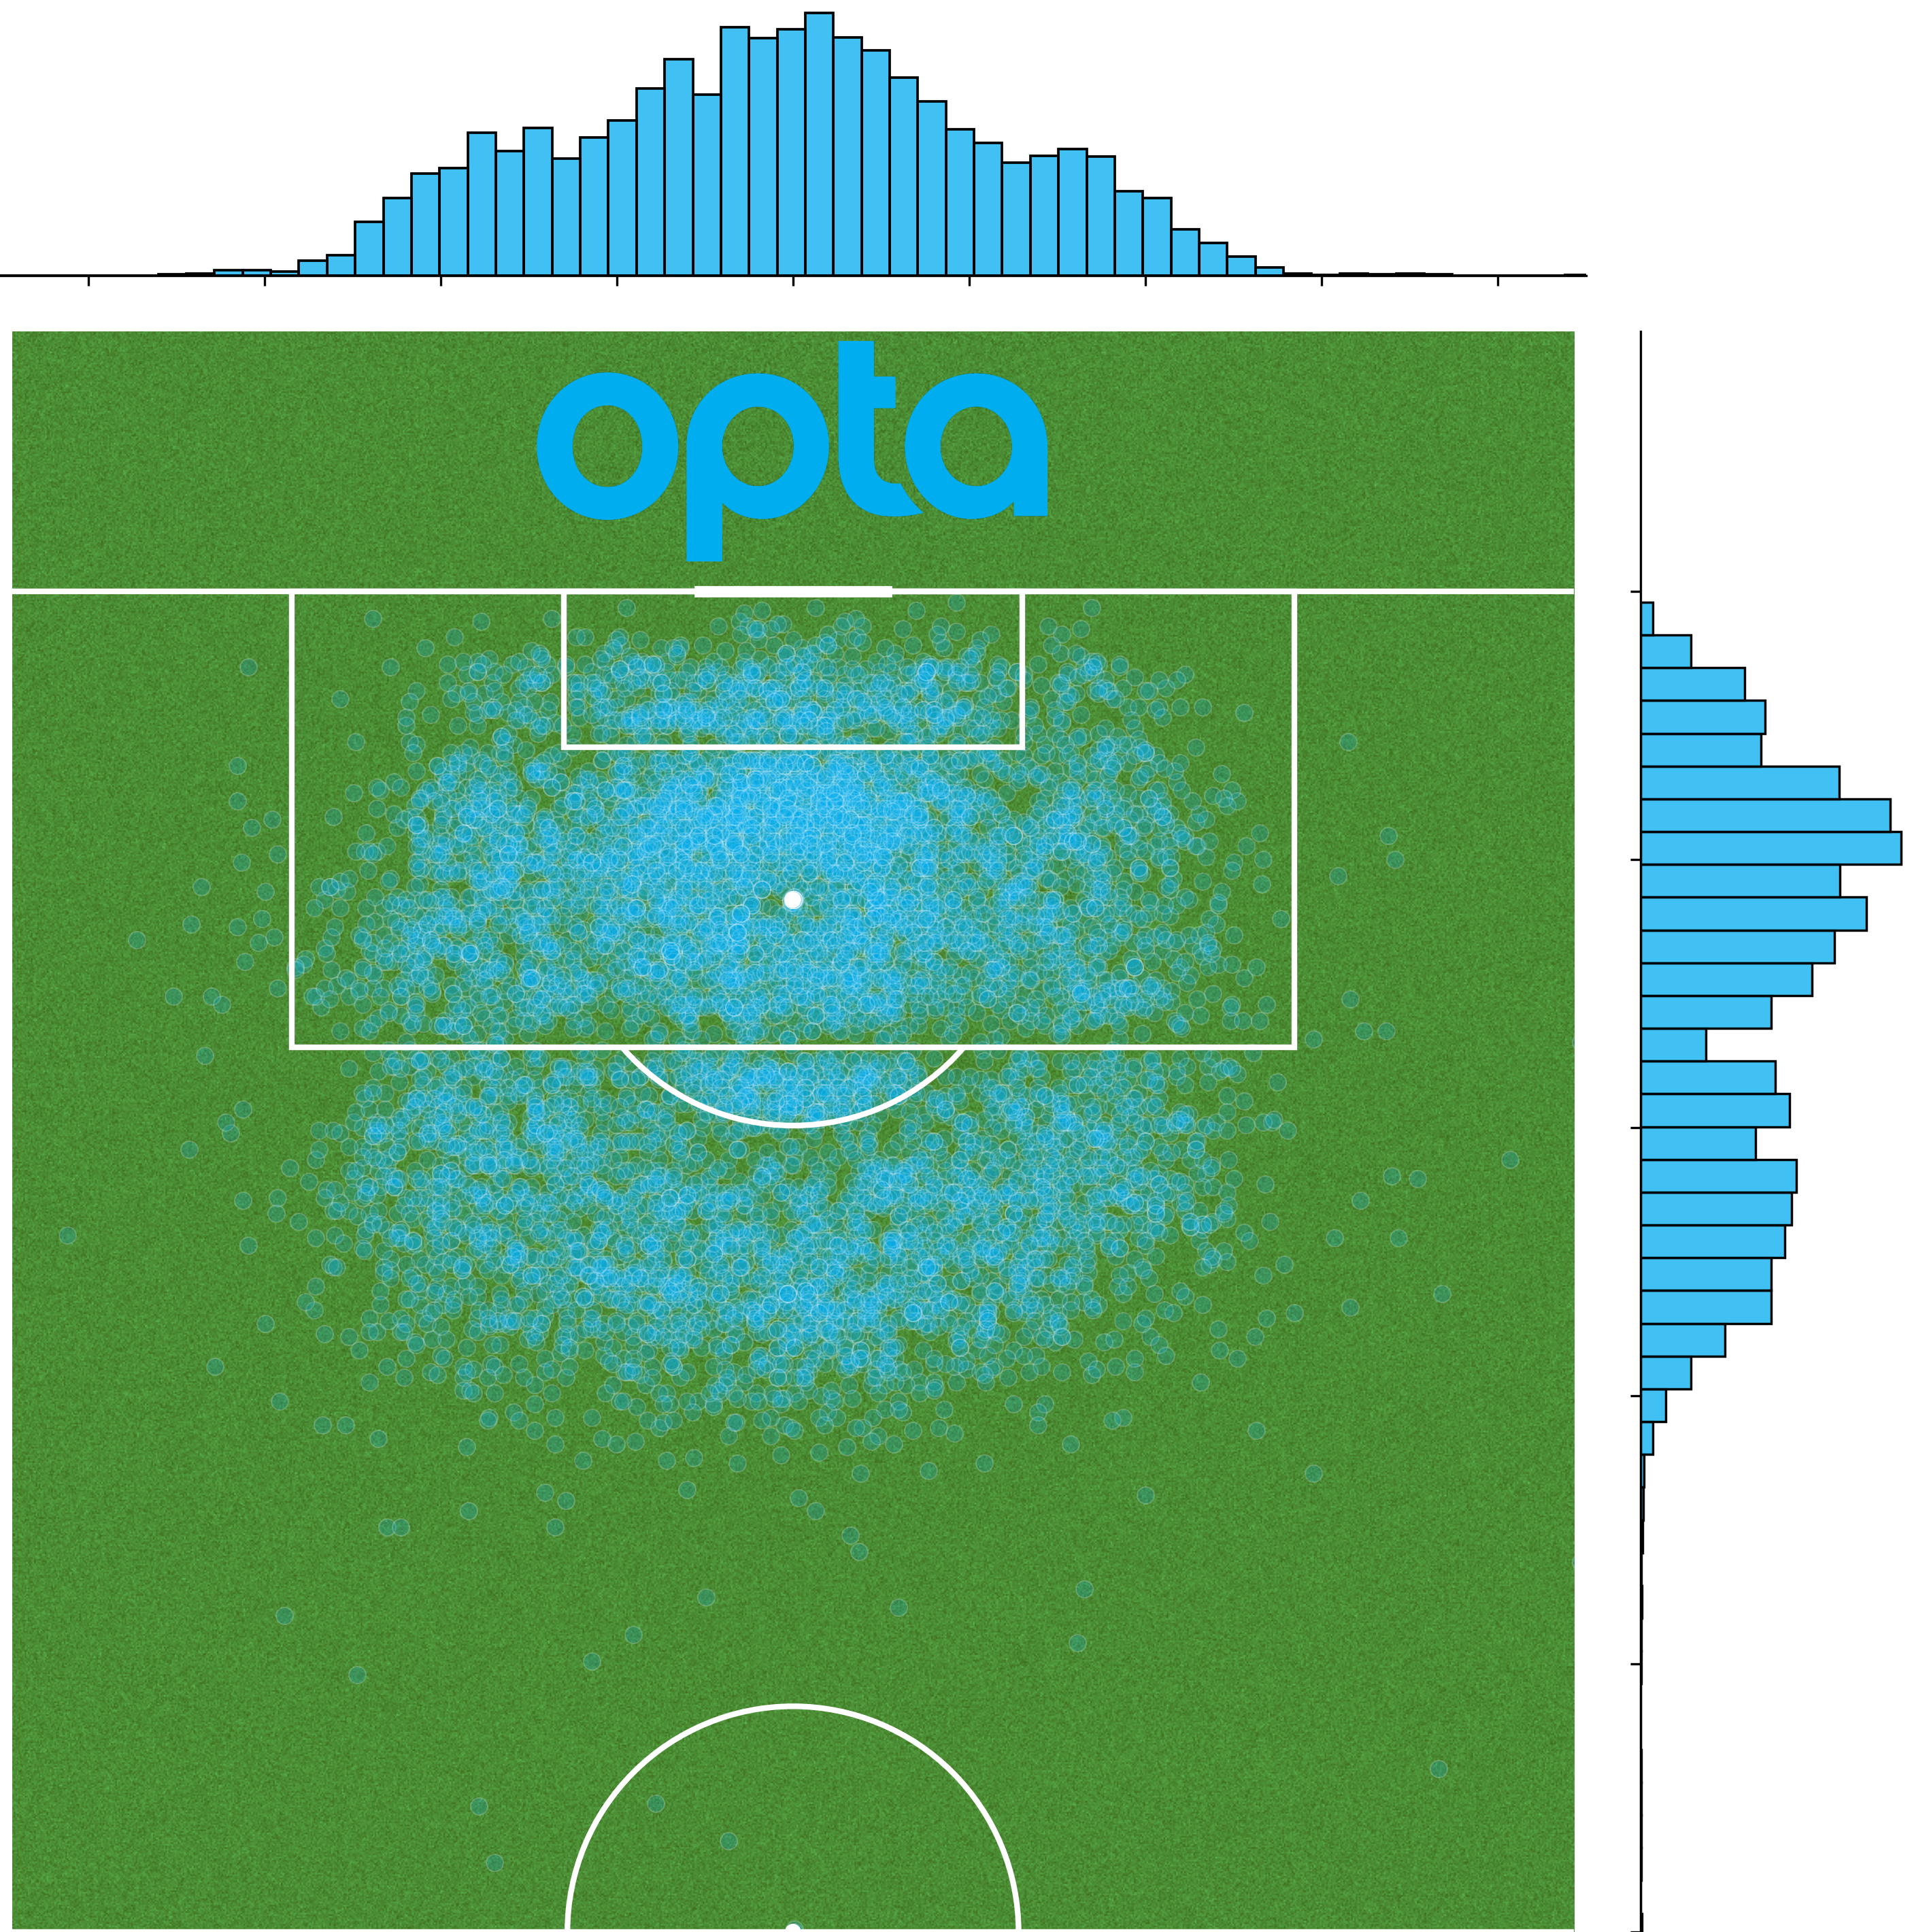
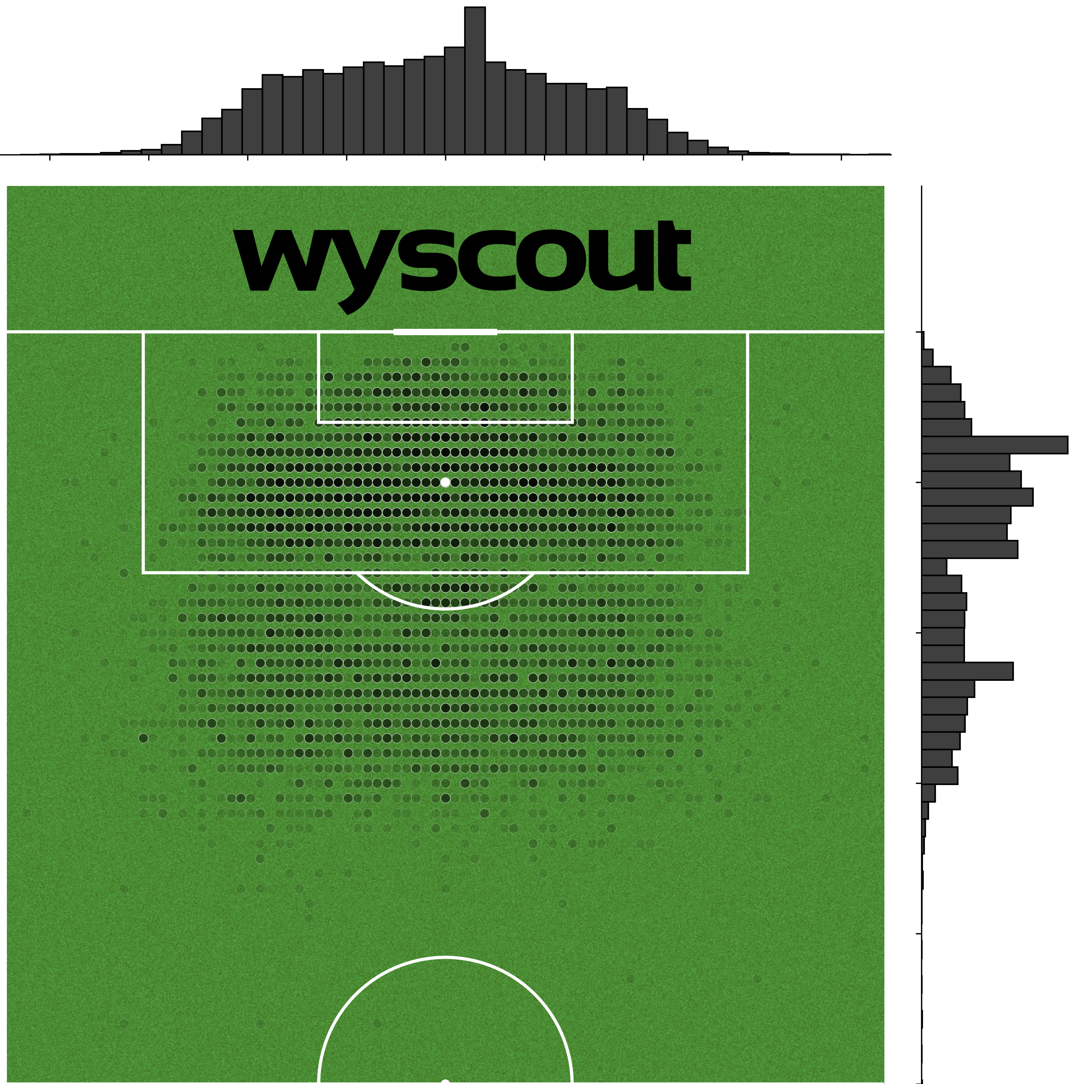
On-the-ball events data
This project utilised on-the-ball events data from two vendors: Opta and Wyscout.
Every on-the-ball action is classified into an events taxonomy and attributed contextual metadata, including player and team identifiers, timestamps, and start and end positional coordinates.
Coverage:
Opta: English Premier League 2017/18–2020/21;
Wyscout: Five major European leagues 2017/18.
Can immediately see differences by looking at shots.
Notes:
Differences:
Precision: 10x granularity in both x and y directions.
Similarity:
Blip on the edge of both penalty areas: human beings collecting the data (and assisted by software) are scattering shots either side of the visual boundary.

Slide 6
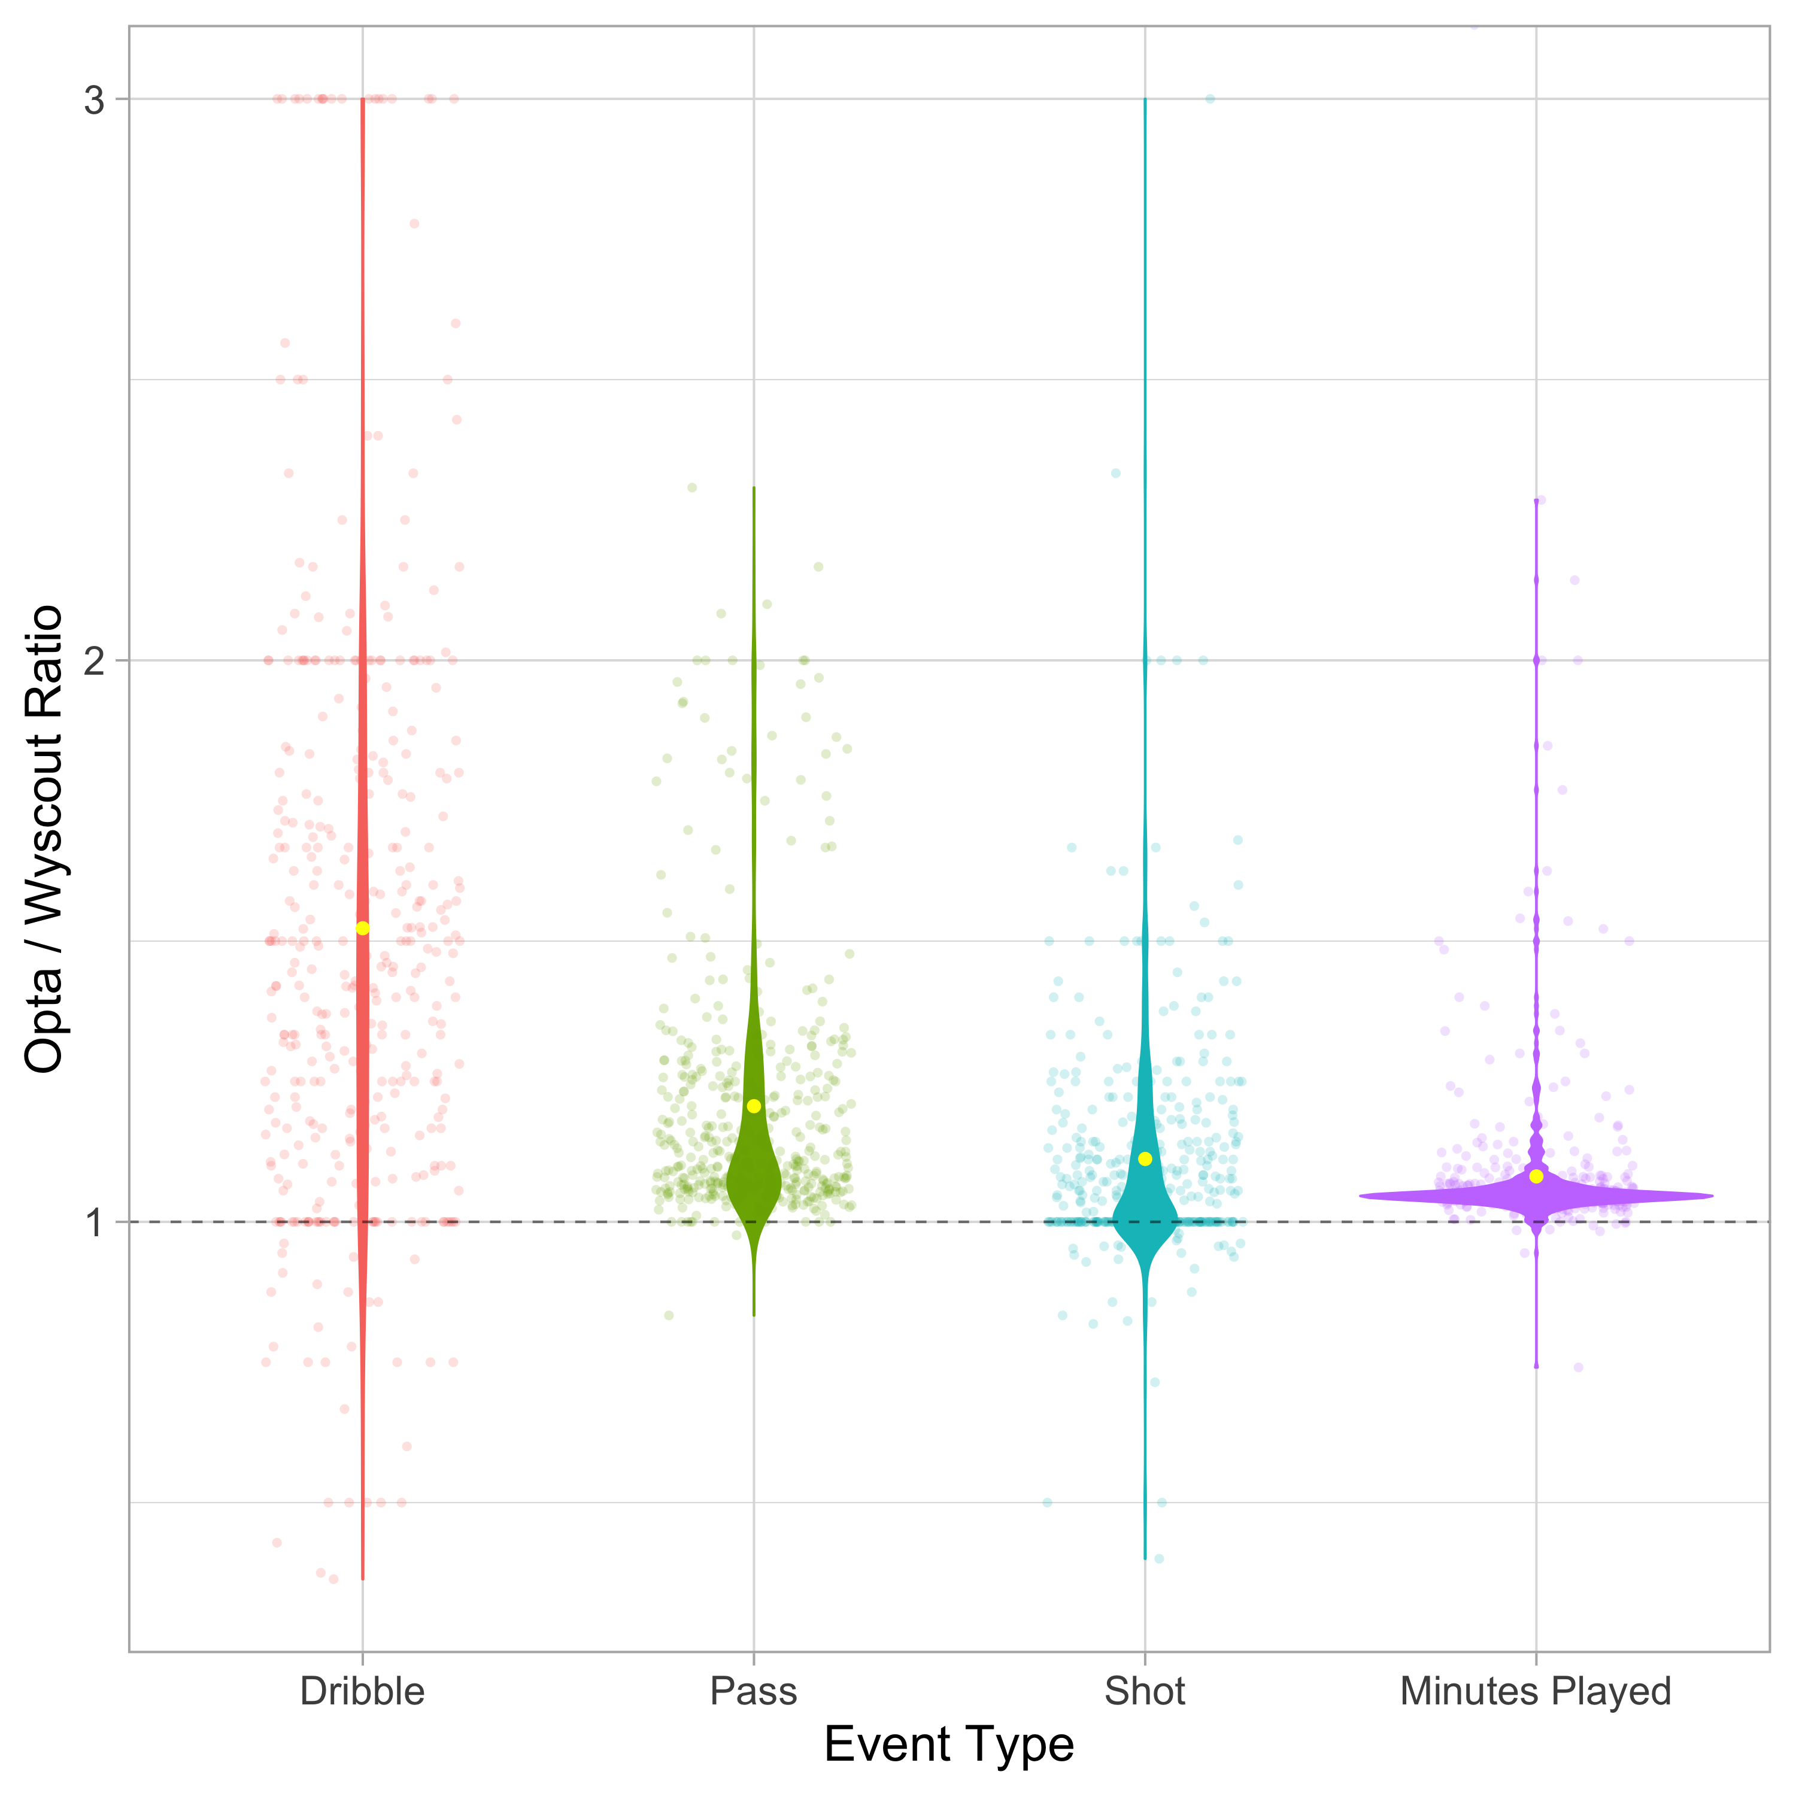
Opta Vs Wyscout: Data quality
Mapped datasets together to perform a systematic data quality comparison.
Calculate Opta:Wyscout ratios for each player in the overlapping 2017/18 season, for the counts of dribbles, passes, shots, mins played.
Wyscout systematically undercounts key actions within a match.
Notes:
Taking a more rigorous look at the data quality differences between two vendors...
Map together: join player, team, action: normalise across three dimensions
Ratios of the counts of actions per player per season for FOUR CRITICAL ACTION TYPES
Example data point: number of shots taken by Marcus Rashford in 2017/18 in Opta divided by the number of shots Rashford took in the same season in the Wyscout data.
Dribbles: NOT EASY TO SYNTHEISE. Have to apply combinations of tags. One combination provided way too many dribbles, the other way too few. STRICTER DEFINITION.
Rare for two players to play the exact same minutes across a season

Slide 7
Opta Vs Wyscout: Data quality
Mapped datasets together to perform a systematic data quality comparison.
Calculate Opta:Wyscout ratios for each player in the overlapping 2017/18 season, for the counts of dribbles, passes, shots, mins played.
Wyscout systematically undercounts key actions within a match.
Wyscout winsorises mins played at 90 minutes, a normalising denominator for apples-to-apples comparisons “per 90”.
Notes:
Look at the distributions of minutes played by player.
Important denominator. Apples to apples. Denominator biased low, metrics biased high.

Slide 8

Modelling
Notes:
For all of our modelling, we're using Opta data.

Slide 9
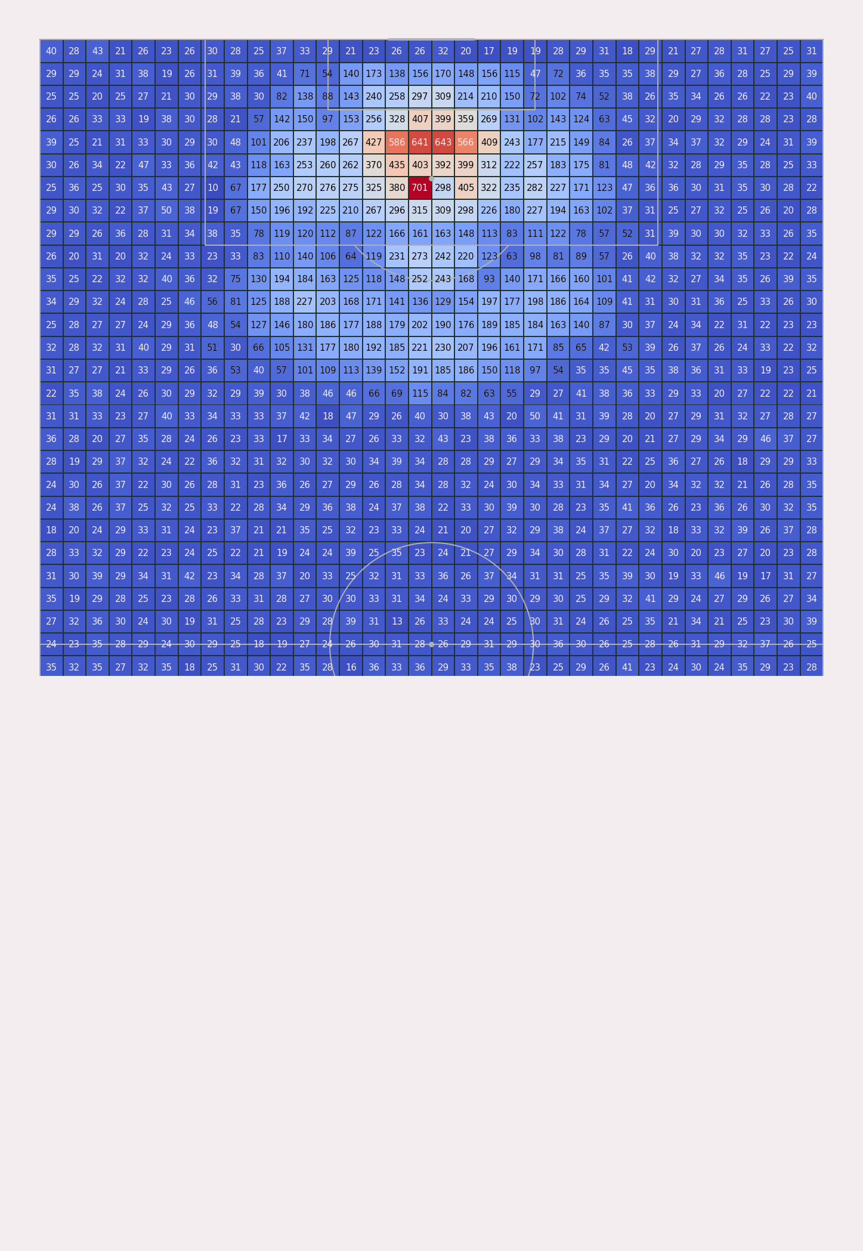
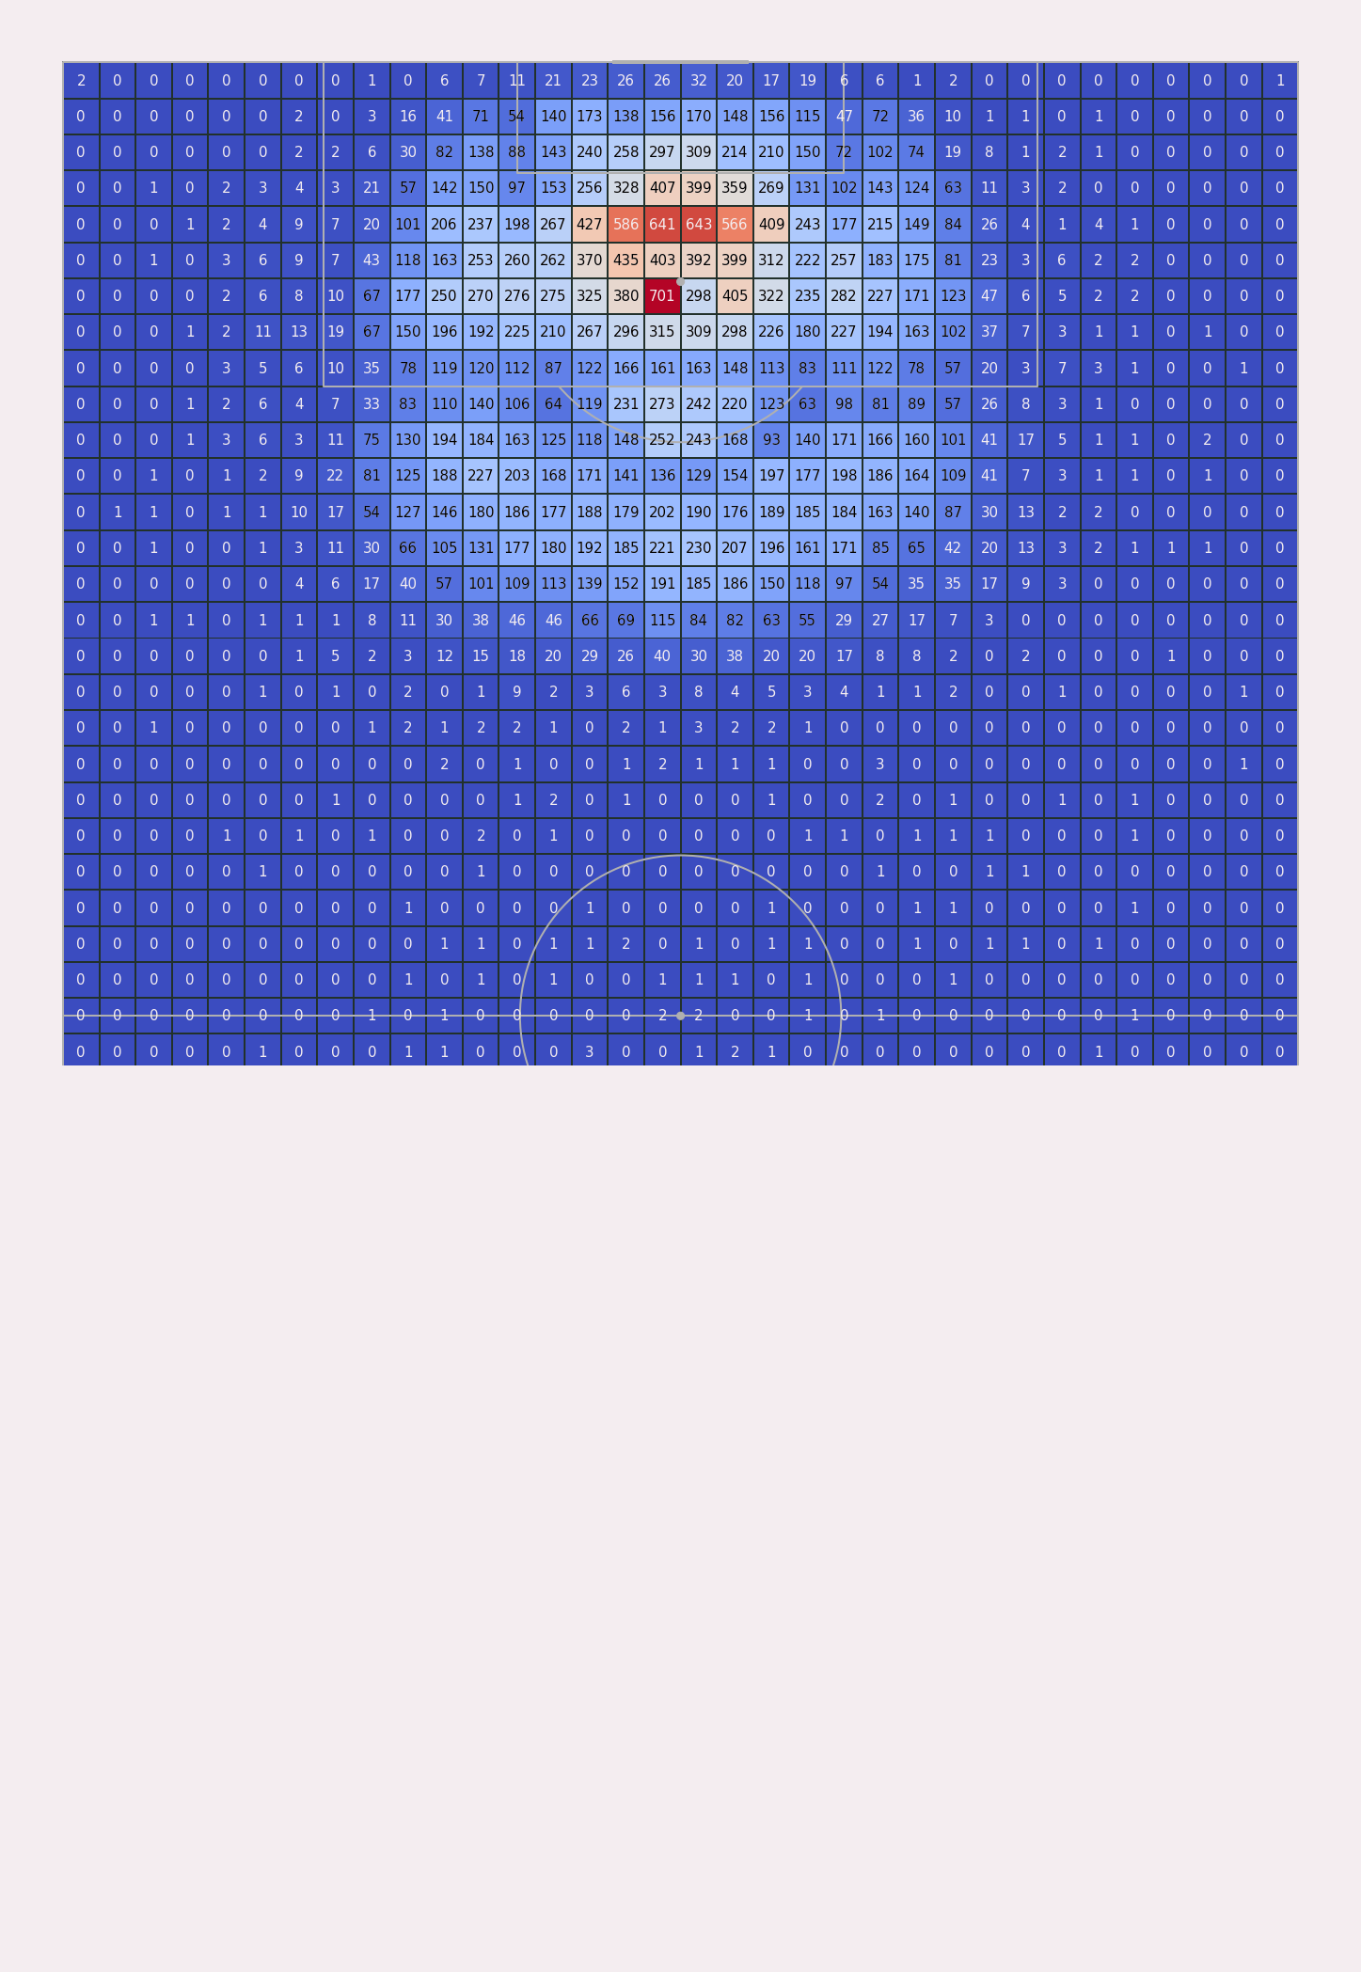
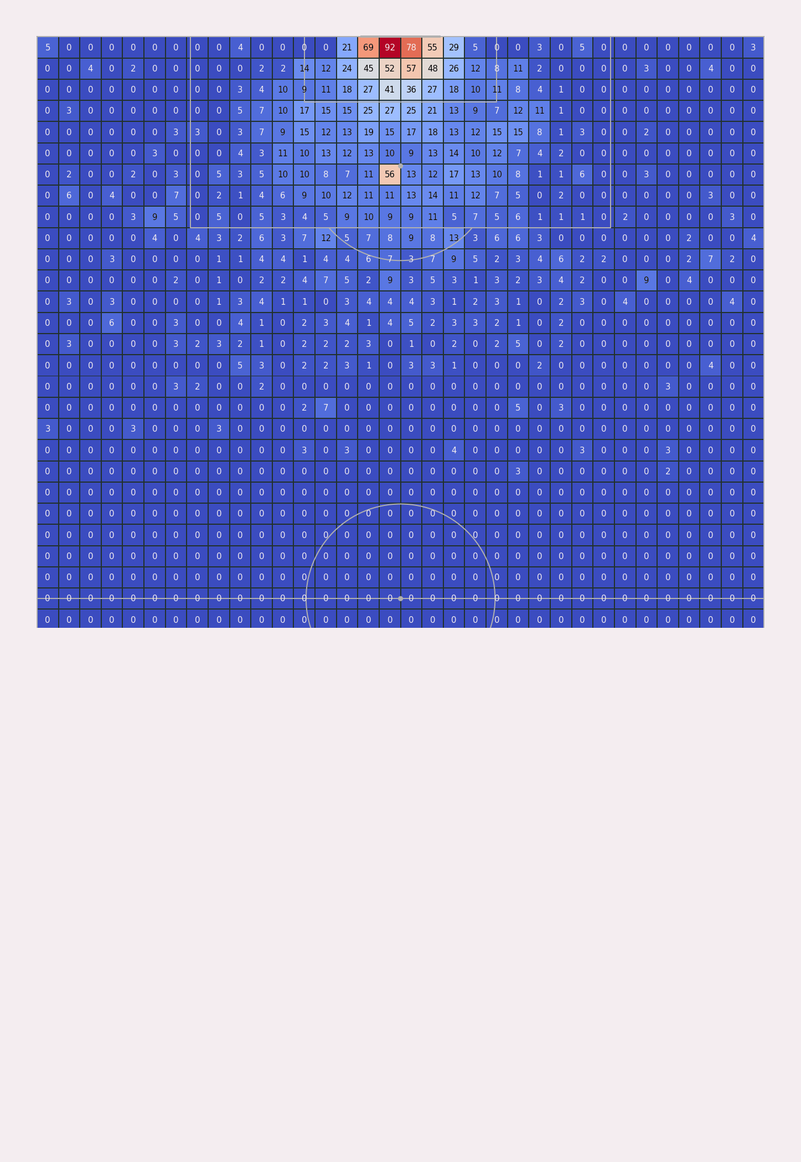
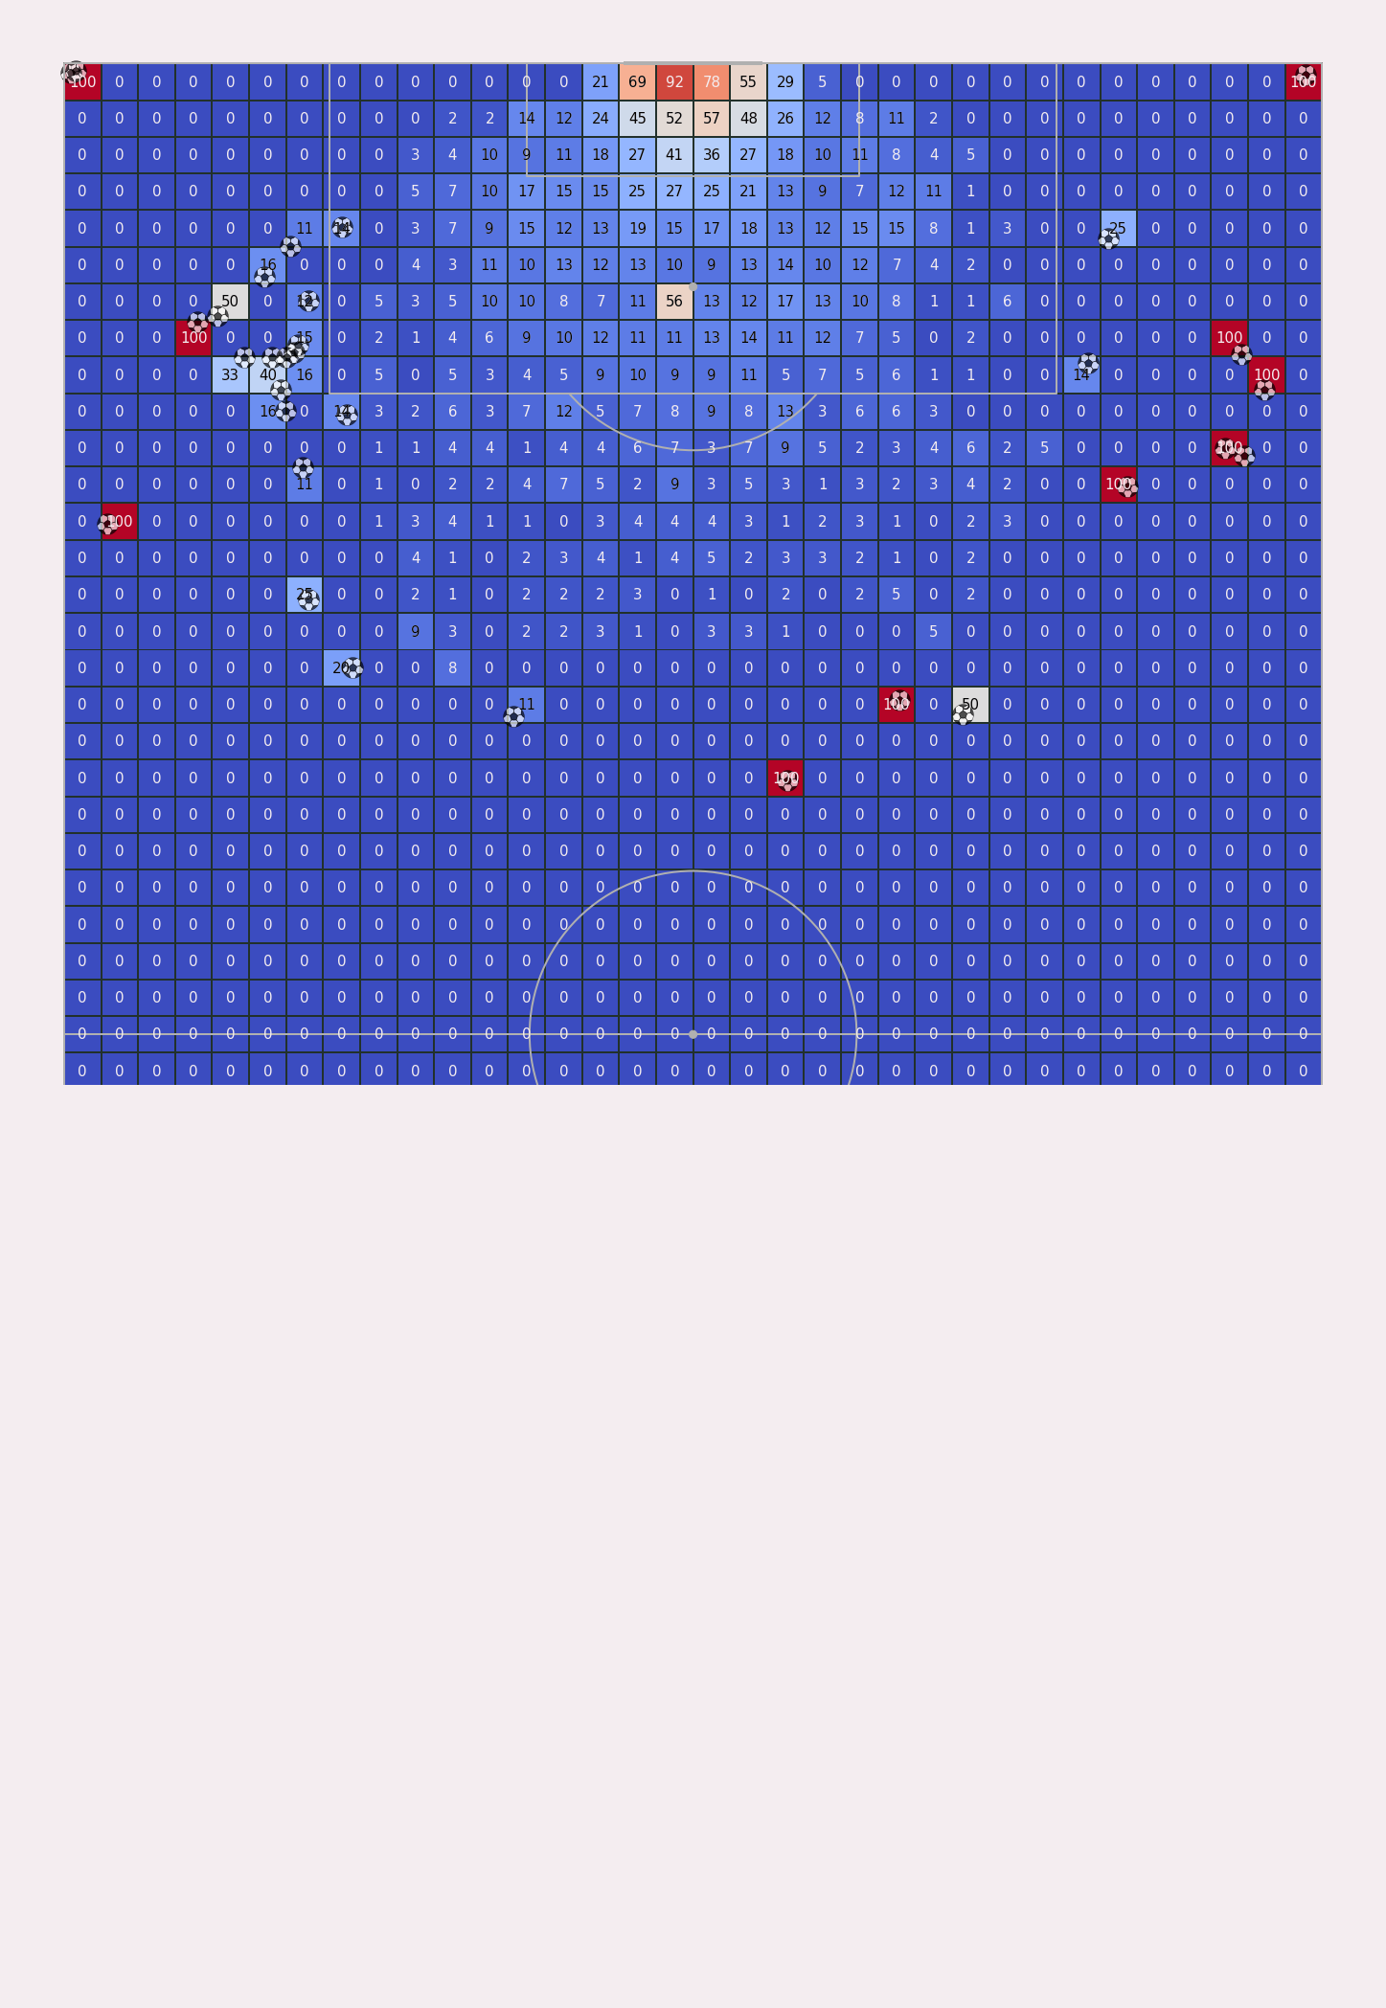
Synthetic shots
Subtle limitation of on-the-ball events is the absence of actions in scenarios with a vanishingly slim chance of success, owing to player domain expertise.
Two forms of outlier:
“Shots” that weren’t intended as shots;
Opportunistic shots where unique context cannot be captured by the data.
Notes:
(Will outline the main limitation in a few slides time…)
Players don’t shoot from their own penalty area as it won’t go in.
Gives rise to two forms of outlier...
Like when corner kicks accidentally go in.
When team is 1-0 down in cup final and goalkeeper goes up for the corner, leaving goal wide open for a long-range shot.

Slide 10
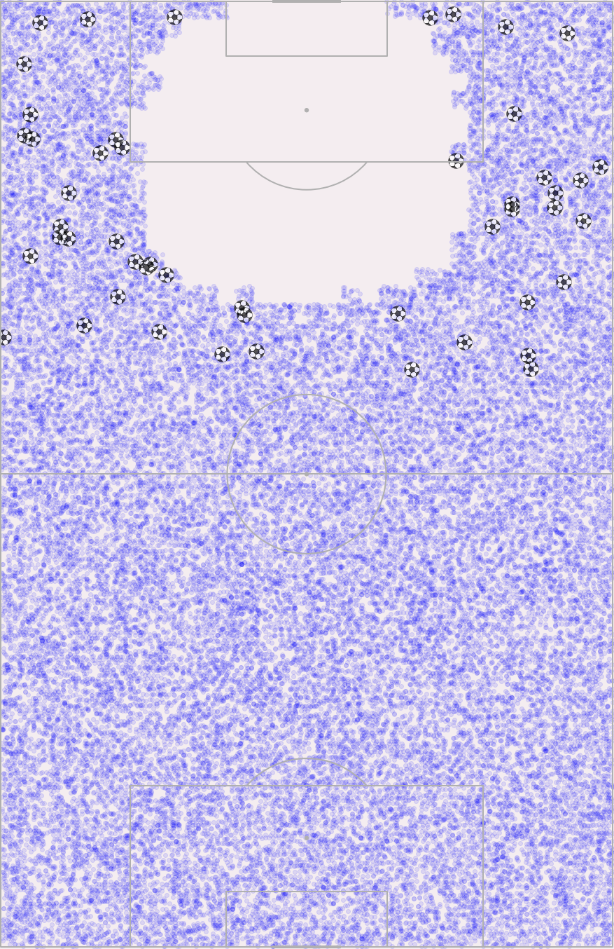
Synthetic shots
Subtle limitation of on-the-ball events is the absence of actions in scenarios with a vanishingly slim chance of success, owing to player domain expertise.
Two forms of outlier:
“Shots” that weren’t intended as shots;
Opportunistic shots where unique context cannot be captured by the data.
Add synthetic shots to encode domain expertise missing from the denominator: the shots not taken because the player had a choice.
Sumpter, 2020
Notes:
One way to address this...
HARD-CODED THERE TO BE ZERO CHANCE OF SCORING FROM ONE’S OWN HALF IN THE SYNTHETIC DATA
SLIM CHANCE OF SUCCESS IN THE REGION AROUND THE PENALTY AREA
HAVE NOT ADDED SYNTHETIC SHOTS IN THIS EMPTY REGION, AS WE ALREADY HAVE REPRESENTITATIVE DATA IN THE REAL SHOTS

Slide 11
Synthetic shots
Produce more realistic shot success surface if players were forced to shoot from outlier location.
A player chooses not to shoot from such outlier locations because a pass or a dribble is, on average, a more valuable action.
Notes:
Leads to logic that'll inform the construction of our first model:

Slide 12
Expected Threat (xT)
Desirable properties of a framework that rewards individual actions:
Rewards buildup play, not just goals and assists;
Rewards actions independent of the end outcome of the possession;
Rewards moving the ball into a location of increased threat, not simply closer to goal.
I. McHale, P. Scarf and D. Folker 2012, Maaike Van Roy et al. 2019
Notes:
Expected Threat is our main model to value actions that move the ball.
A world class through ball by a creative midfielder that is wasted by a striker who misses a glorious chance should still get points.
Not just moving closer to goal. A lot of teams play wide, taking the ball further from goal, to increase their chances of scoring: want to capture this

Slide 13
Expected Threat (xT)
Desirable properties of a framework that rewards individual actions:
Rewards buildup play, not just goals and assists;
Rewards actions independent of the end outcome of the possession;
Rewards moving the ball into a location of increased threat, not simply closer to goal.
Modelled possession sequences as Markov chains where players choose whether to move the ball or shoot to produce a value surface on the pitch:
Consecutive actions that move the ball represent transient states;
Possession turnovers and goals represent absorbing states;
xT more sophisticated than count-based regression approaches (EA Index);
xT more intuitive and interpretable than machine learning approaches (VAEP).
I. McHale, P. Scarf and D. Folker 2012, Maaike Van Roy et al. 2019
Notes:
Count-based: regress onto goals scored. All passes are counted equally, all crosses are counted equally, all dribbles are counted equally, based on the regression coefficients. Just sum the coefficients based on the counts of actions performed by a player.
ML-based. Much more of a black box that lacks the interpretability and intuition that’s essential for adoption into a practitioner’s toolkit.

Slide 14
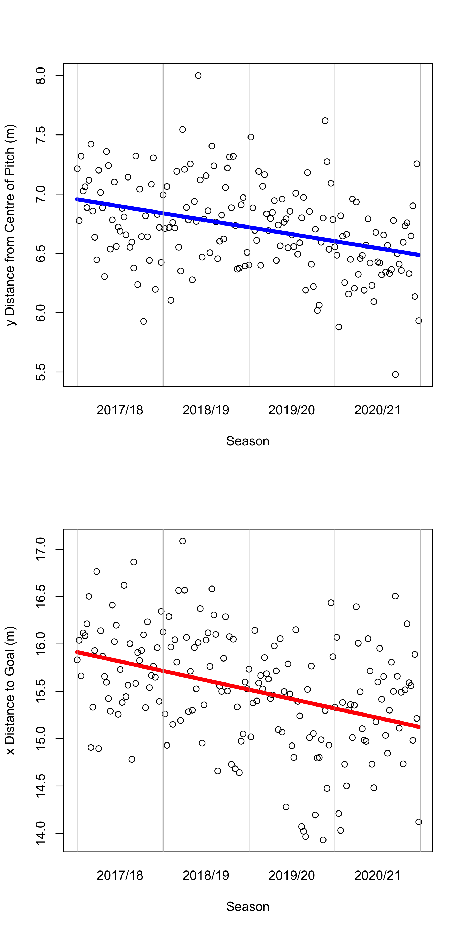
Motivating a Bayesian approach
Team strategy and player behavior is evolving.
Shots are typically being taken more central to the middle of the pitch and closer to goal.
p values associated with negative gradient coefficients statistically significant at the 0.1% level of significance.
Players are “making the goal bigger” before they shoot.
Bayesian updating:
Use previous season’s data as prior and update xT value action surface monthly.
Notes:
Before we delve into model details, first motivate taking a Bayesian approach...
IF YOU DRAW A LINE THAT BISECTS BOTH PENALTY SPOTS, IT’S THE DISTANCE TO THAT LINE.

Slide 15
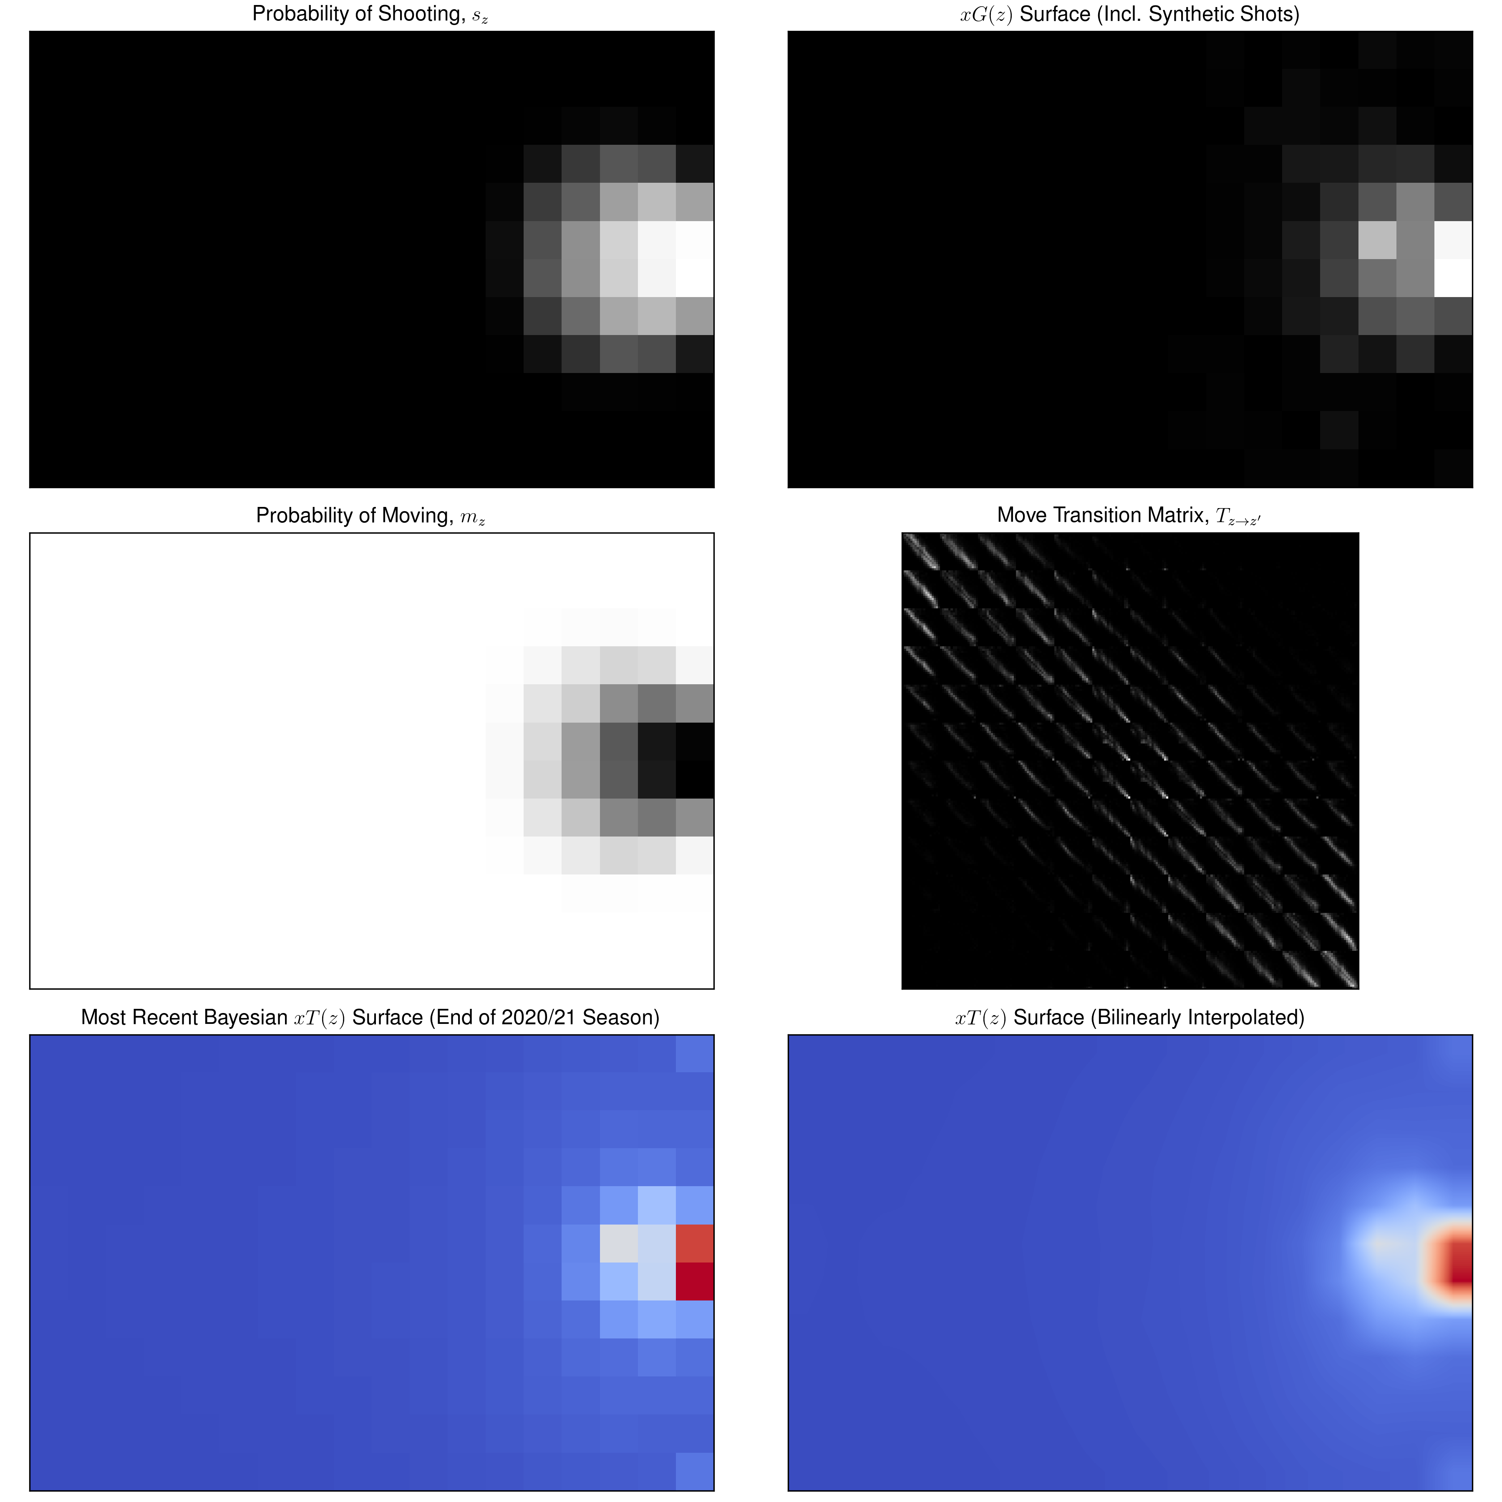
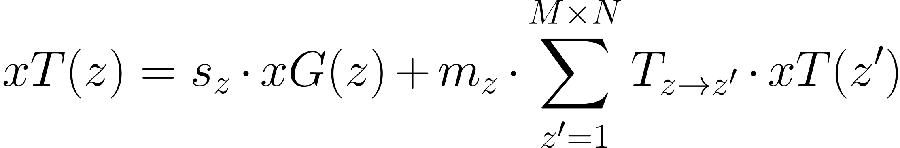
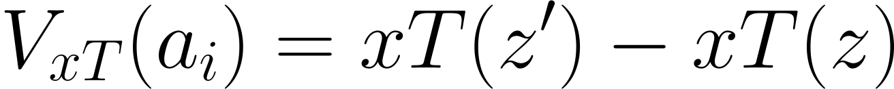
Bayesian xT model
Create xT value surface by overlaying M x N grid, of zones, z, reflecting the probability of scoring a goal at a later state given the current position via:
Actions are valued by the difference between start and finish positions on the xT surface:
Initialise xT(z) at 0 and solve via dynamic programming.
s_{z}
xG(z)
m_{z}
T
xT(z)
Singh, 2019.
Notes:
And now to specify our Bayesian Markov xT model:
* Overlay an MxN grid of zones (we’ve done 12x18 here)
* Create xT value surface, which reflects the probability of scoring a goal later in the possession given the current zone
4 components:
xG conditional probability of scoring if shoot
Iterate towards convergence.

Slide 16
Bayesian xT model innovations
Applied bilinear interpolation to take advantage of Opta’s positional granularity.
Beta-Binomial conjugate system: updating 47,304 priors each month for 12 x 18 pitch.
Encode domain expertise via synthetic shot data as part of xG prior.
Easy to integrate data from any vendor.
s_{z}
xG(z)
m_{z}
T
xT(z)
Notes:
4 innovations beyond the original implementation by Karun Singh…
Positional granularity – CSI enhance. AS YOU GET CLOSER TO GOAL, SMALL MOVEMENTS CAN HAVE BIG IMPACTS ON THE LIKELIHOOD OF SCORING. If you can’t escape the pixel, you get 0 score.
Beta-Binomial: every element of each of the four components is a probability -> most updates for Transition matrix as that’s 12x18 squared.
Encoding domain expertise: provides INTERFACE for data scientist to collaborate with non-technical domain experts within the club.

Slide 17
Expected Goals (xG)
xT purely values actions that move the ball. Attributes zero value to shots.
Expected Goals describes shot chance quality as the conditional probability of a successful shot given the shot situation.
Nearly 25 years after the introduction of the first logistic regression xG model, still the practitioner’s choice to describe the most important features.
Excess xG:
Calculated as the difference between the actual outcome and xG;
Metric to value shot actions to complement xT.
Pollard & Reep, 1997.
Notes:
SLIDE
(Second xG Model: additional features beyond location, will describe feature engineering next slide).
Excess xG & xT provides set of metrics to value shots, passes, dribbles, and crosses.

Slide 18
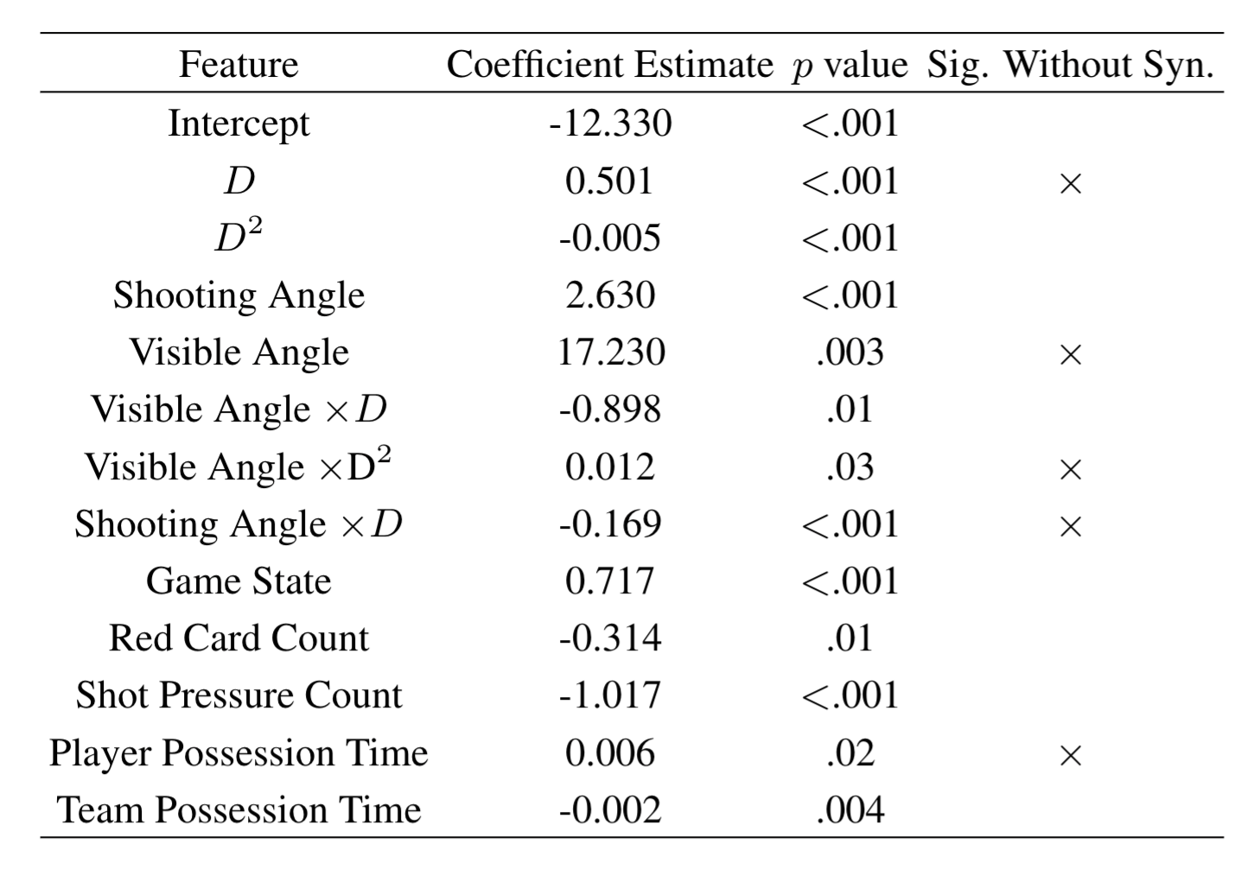
xG feature engineering
Basic features:
x distance to goal;
y distance from centre of pitch.
Added features:
Distances to goal mid-point;
Shot angles.
Advanced features:
Contextual features;
Distance-angle interactions.
Advanced model trained with and without synthetic shots.
Sumpter, 2016.
Notes:
"Built three sets of features as part of the xG feature engineering, produced 3 different models."
Basic features the same as Bayesian motivation.
Angles:
Simple trigonometry
More sophisticated, represents the amount of goal the striker can see, covered in Sumpter’s book: Soccermatics.
Showing the benefit of encoding domain expertise into model training - can push the interaction terms further.

Slide 19
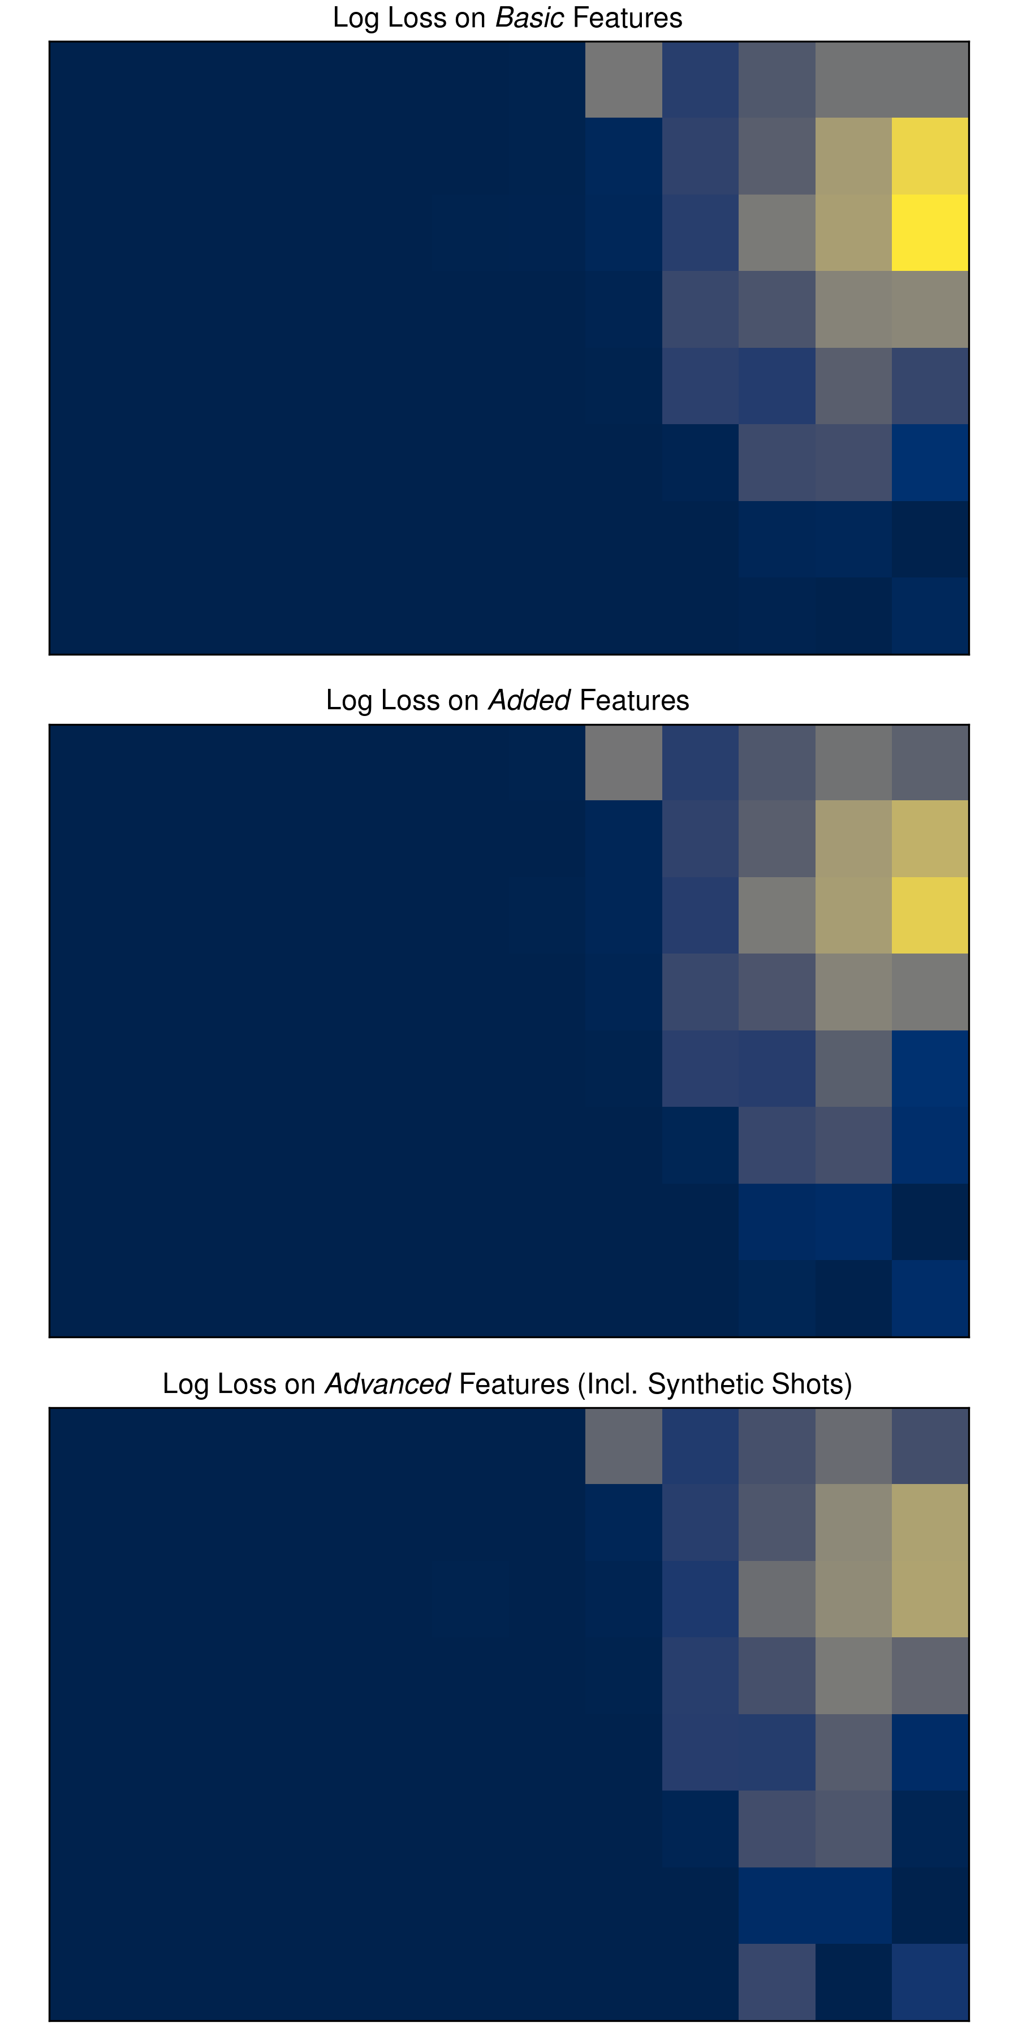
xG model log loss & calibration
Wish to produce well-calibrated model with the smallest log loss possible.
All models used the same test data.
Not a single goal predicted by the basic model despite 90% accuracy!
Advanced model best-calibrated and has lowest log loss Vs literature.
Often, best way to improve model performance is to use better data.
0.293
0.288
0.253
Eggels 2016, Van den Hoek 2019, Noordman 2019.
Notes:
To quantitatively measure how good our xG forecasts are, we focused on log loss and the calibration of the forecasts.

Slide 20

Applications

Slide 21
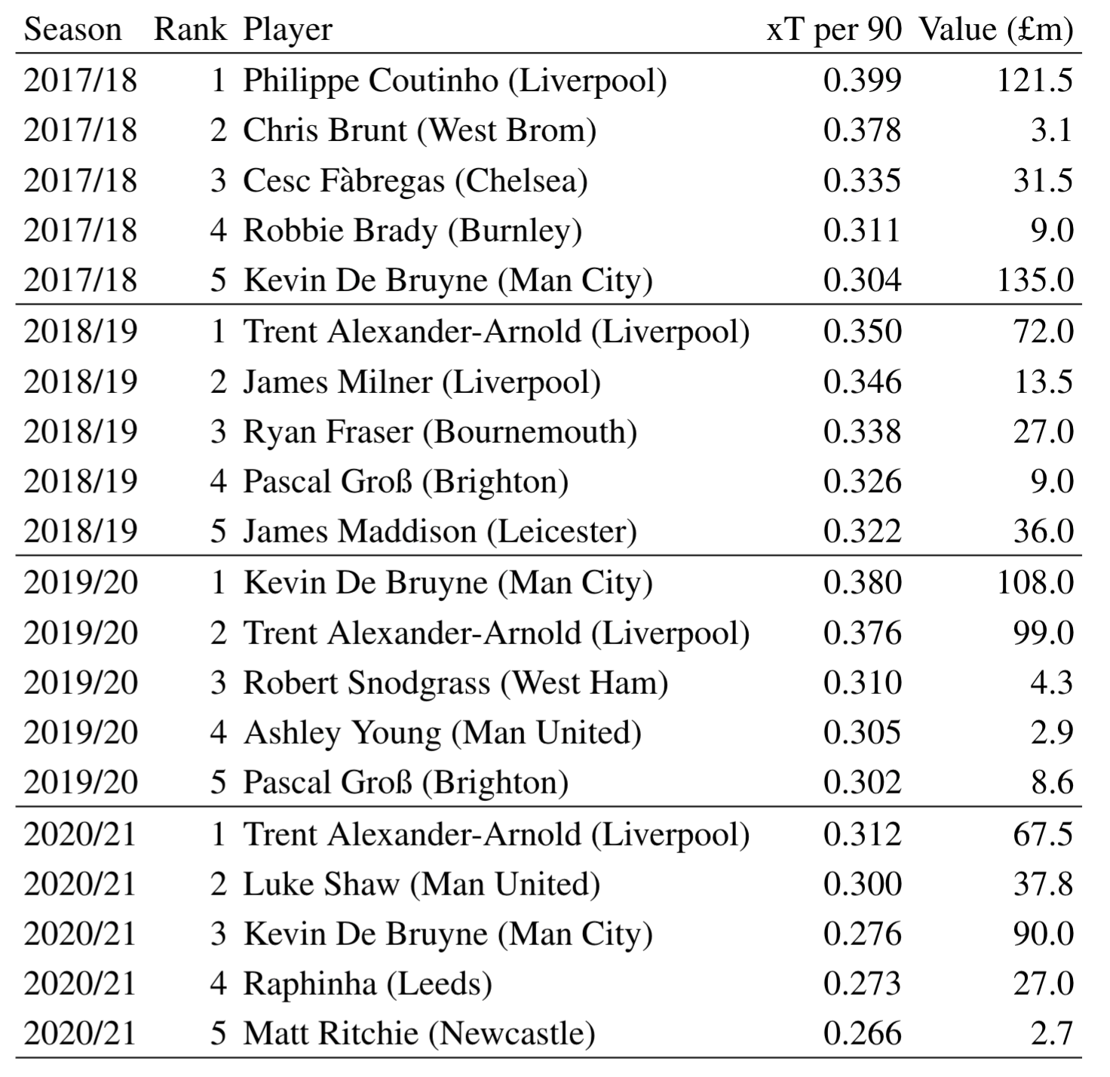
Player xT
Ranking the Premier League’s most threatening players via xT per 90 mins.
2019/20 PFA Player of the Year de Bruyne and 2019/20 Young Player of the Year Alexander-Arnold perennial generators of threat.
Notes:
FIRST APPLICATION LOOK AT Player xT: RANKING THE.....
Serves a dual purpose, allowing us to evaluate the validity of the value action framework.
Want our model to agree with an expert panel of judges as to how the Premier League's very best players are.
This was the disaster in the EA index where goalkeepers kept being ranked as the best players!
PFA = Professional Footballers Association
USEFUL SANITY CHECK OF OUR MODEL

Slide 22
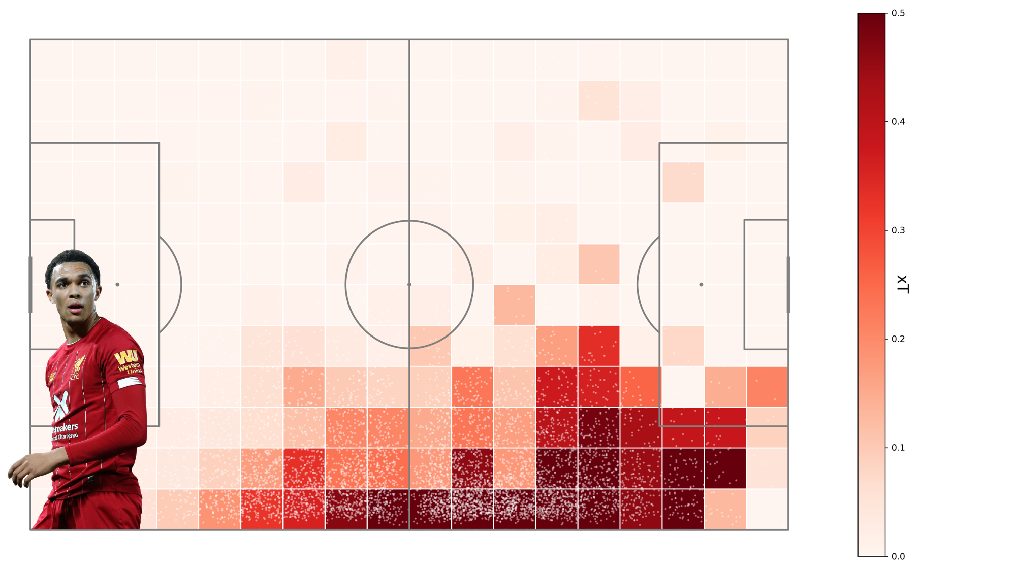
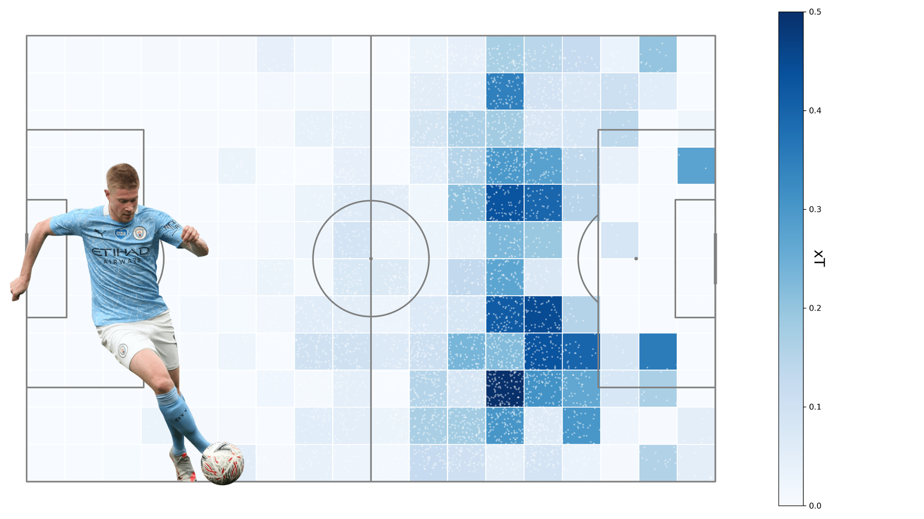
Player xT
Ranking the Premier League’s most threatening players via xT per 90 mins.
2019/20 PFA Player of the Year de Bruyne and 2019/20 Young Player of the Year Alexander-Arnold perennial generators of threat.
Alexander-Arnold generates threat in wide areas, whereas de Bruyne operates centrally.
Notes:
TAA fans threat towards the opposition box as he approaches the final third.
KDB operates centrally, generating threat in the spaces between centre halves and full backs.

Slide 23
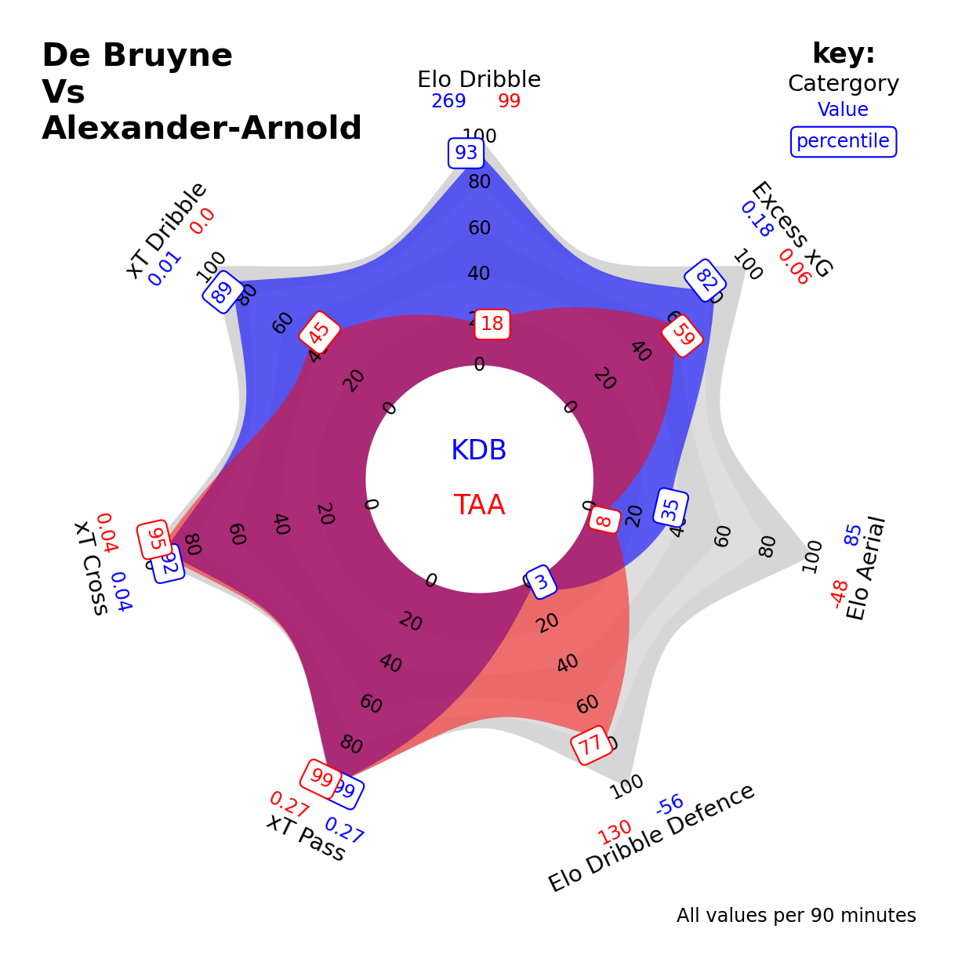
Player xT
Ranking the Premier League’s most threatening players via xT per 90 mins.
2019/20 PFA Player of the Year de Bruyne and 2019/20 Young Player of the Year Alexander-Arnold perennial generators of threat.
Alexander-Arnold generates threat in wide areas, whereas de Bruyne operates centrally.
Both exceptional at crossing and passing. De Bruyne the superior dribbler and finisher. Alexander-Arnold the superior defender.
Notes:
And now we introduce our first player radar.
We present actual values as well as percentiles to enable comparison between players across a suite of metrics:
* xT by cross, dribble, pass;
Excess xG
Also 3 additional Elo-based metrics. Elo is a rating system used to score chess players, and we’ve implemented a similar system to rate and rank players in duels like dribbles and aerial headers.

Slide 24
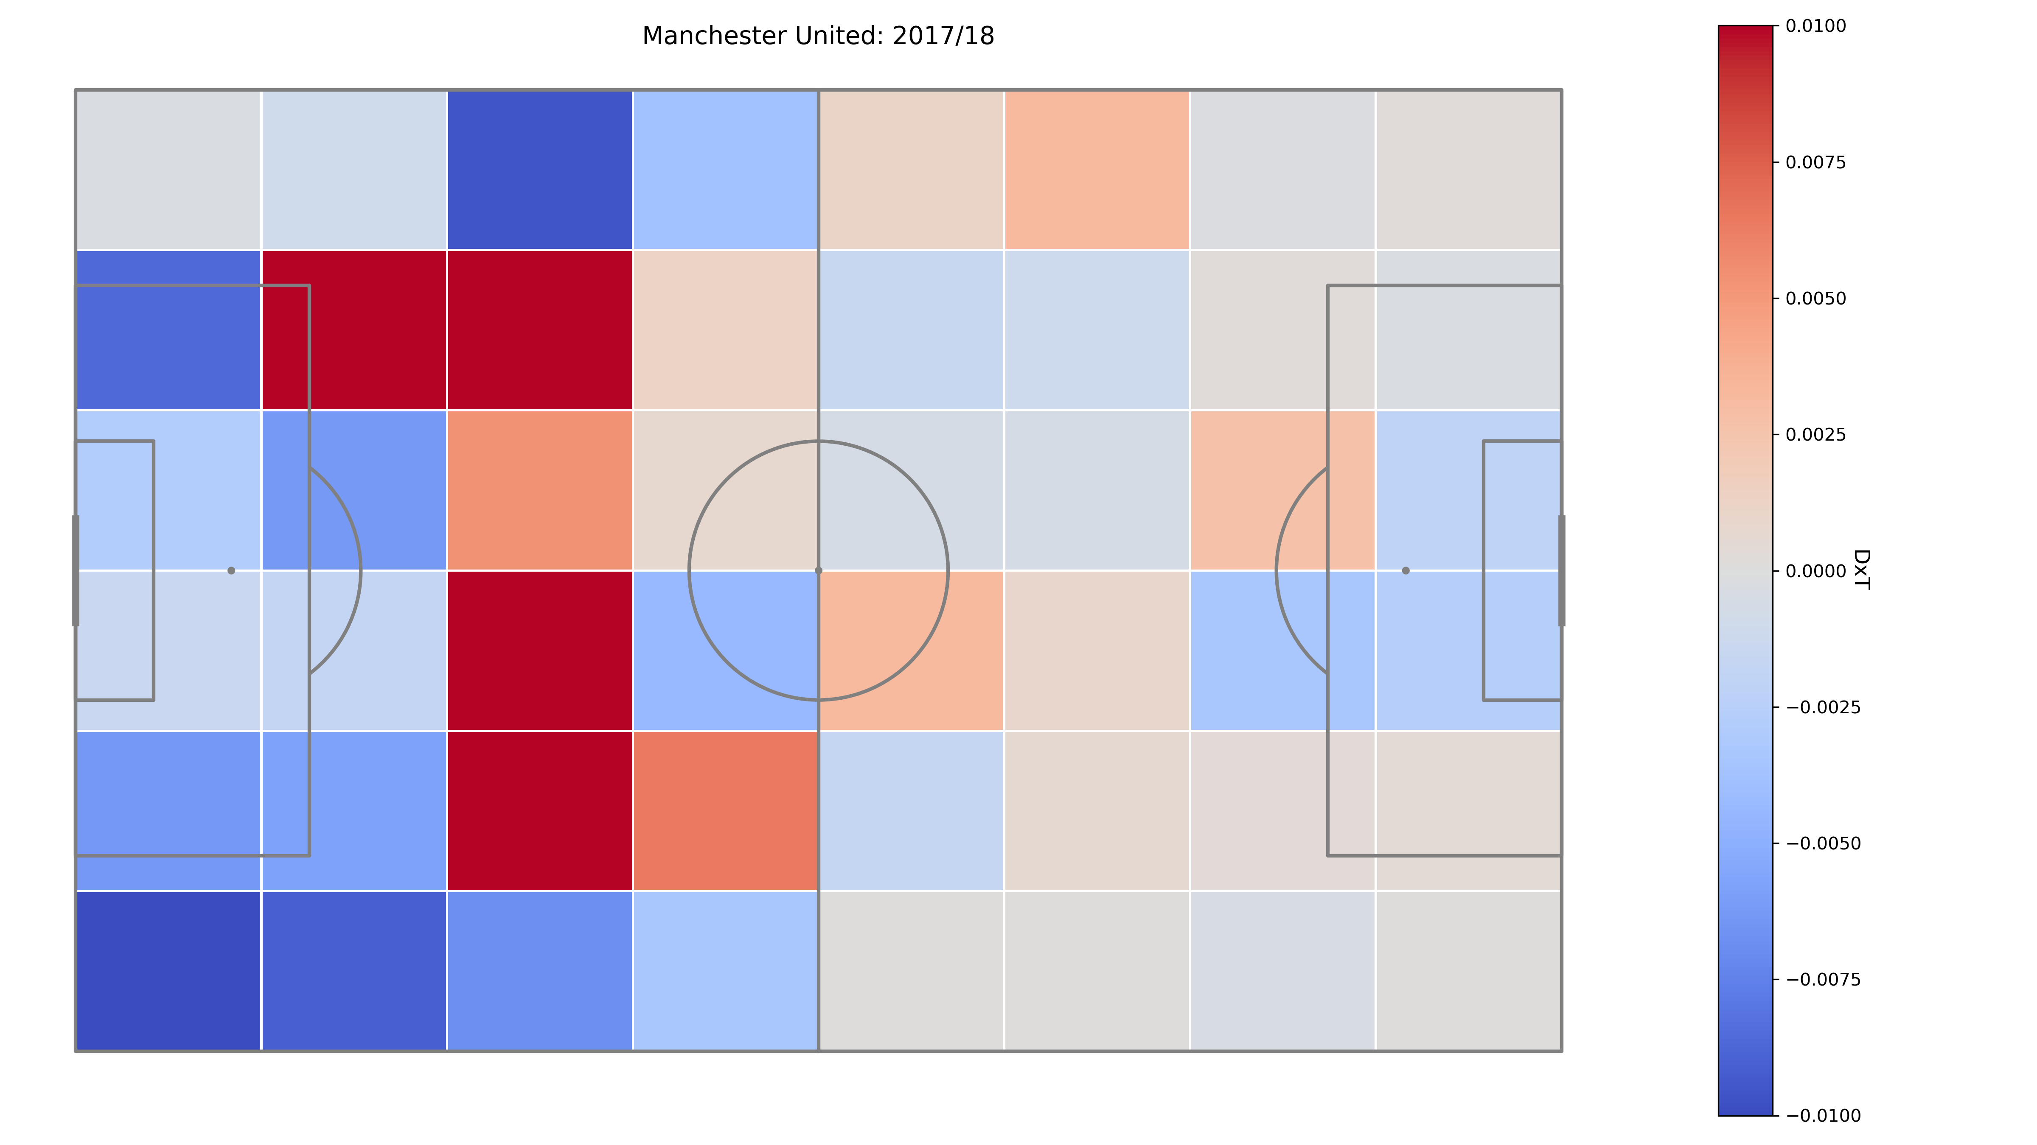
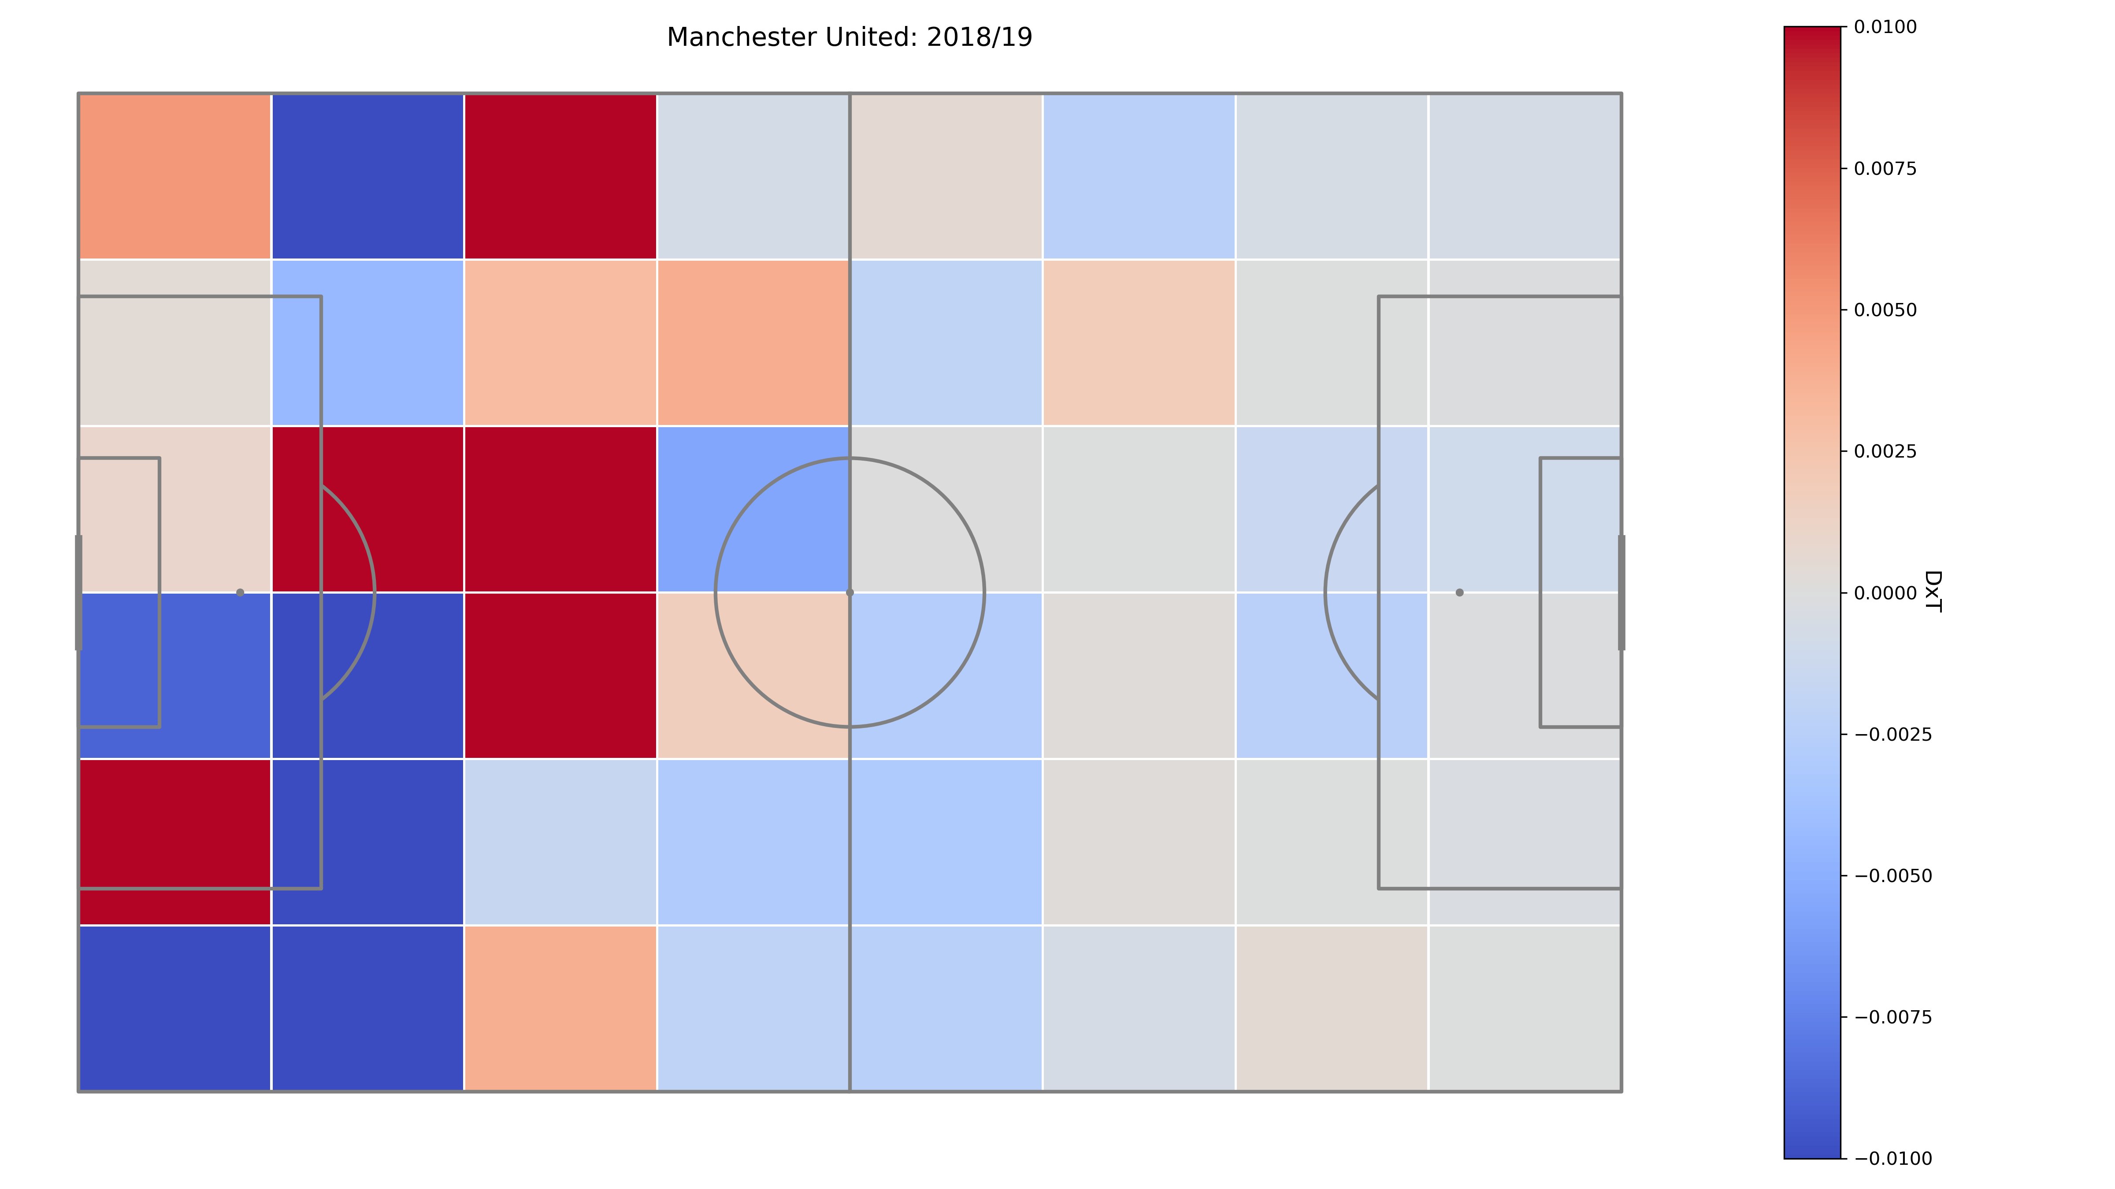
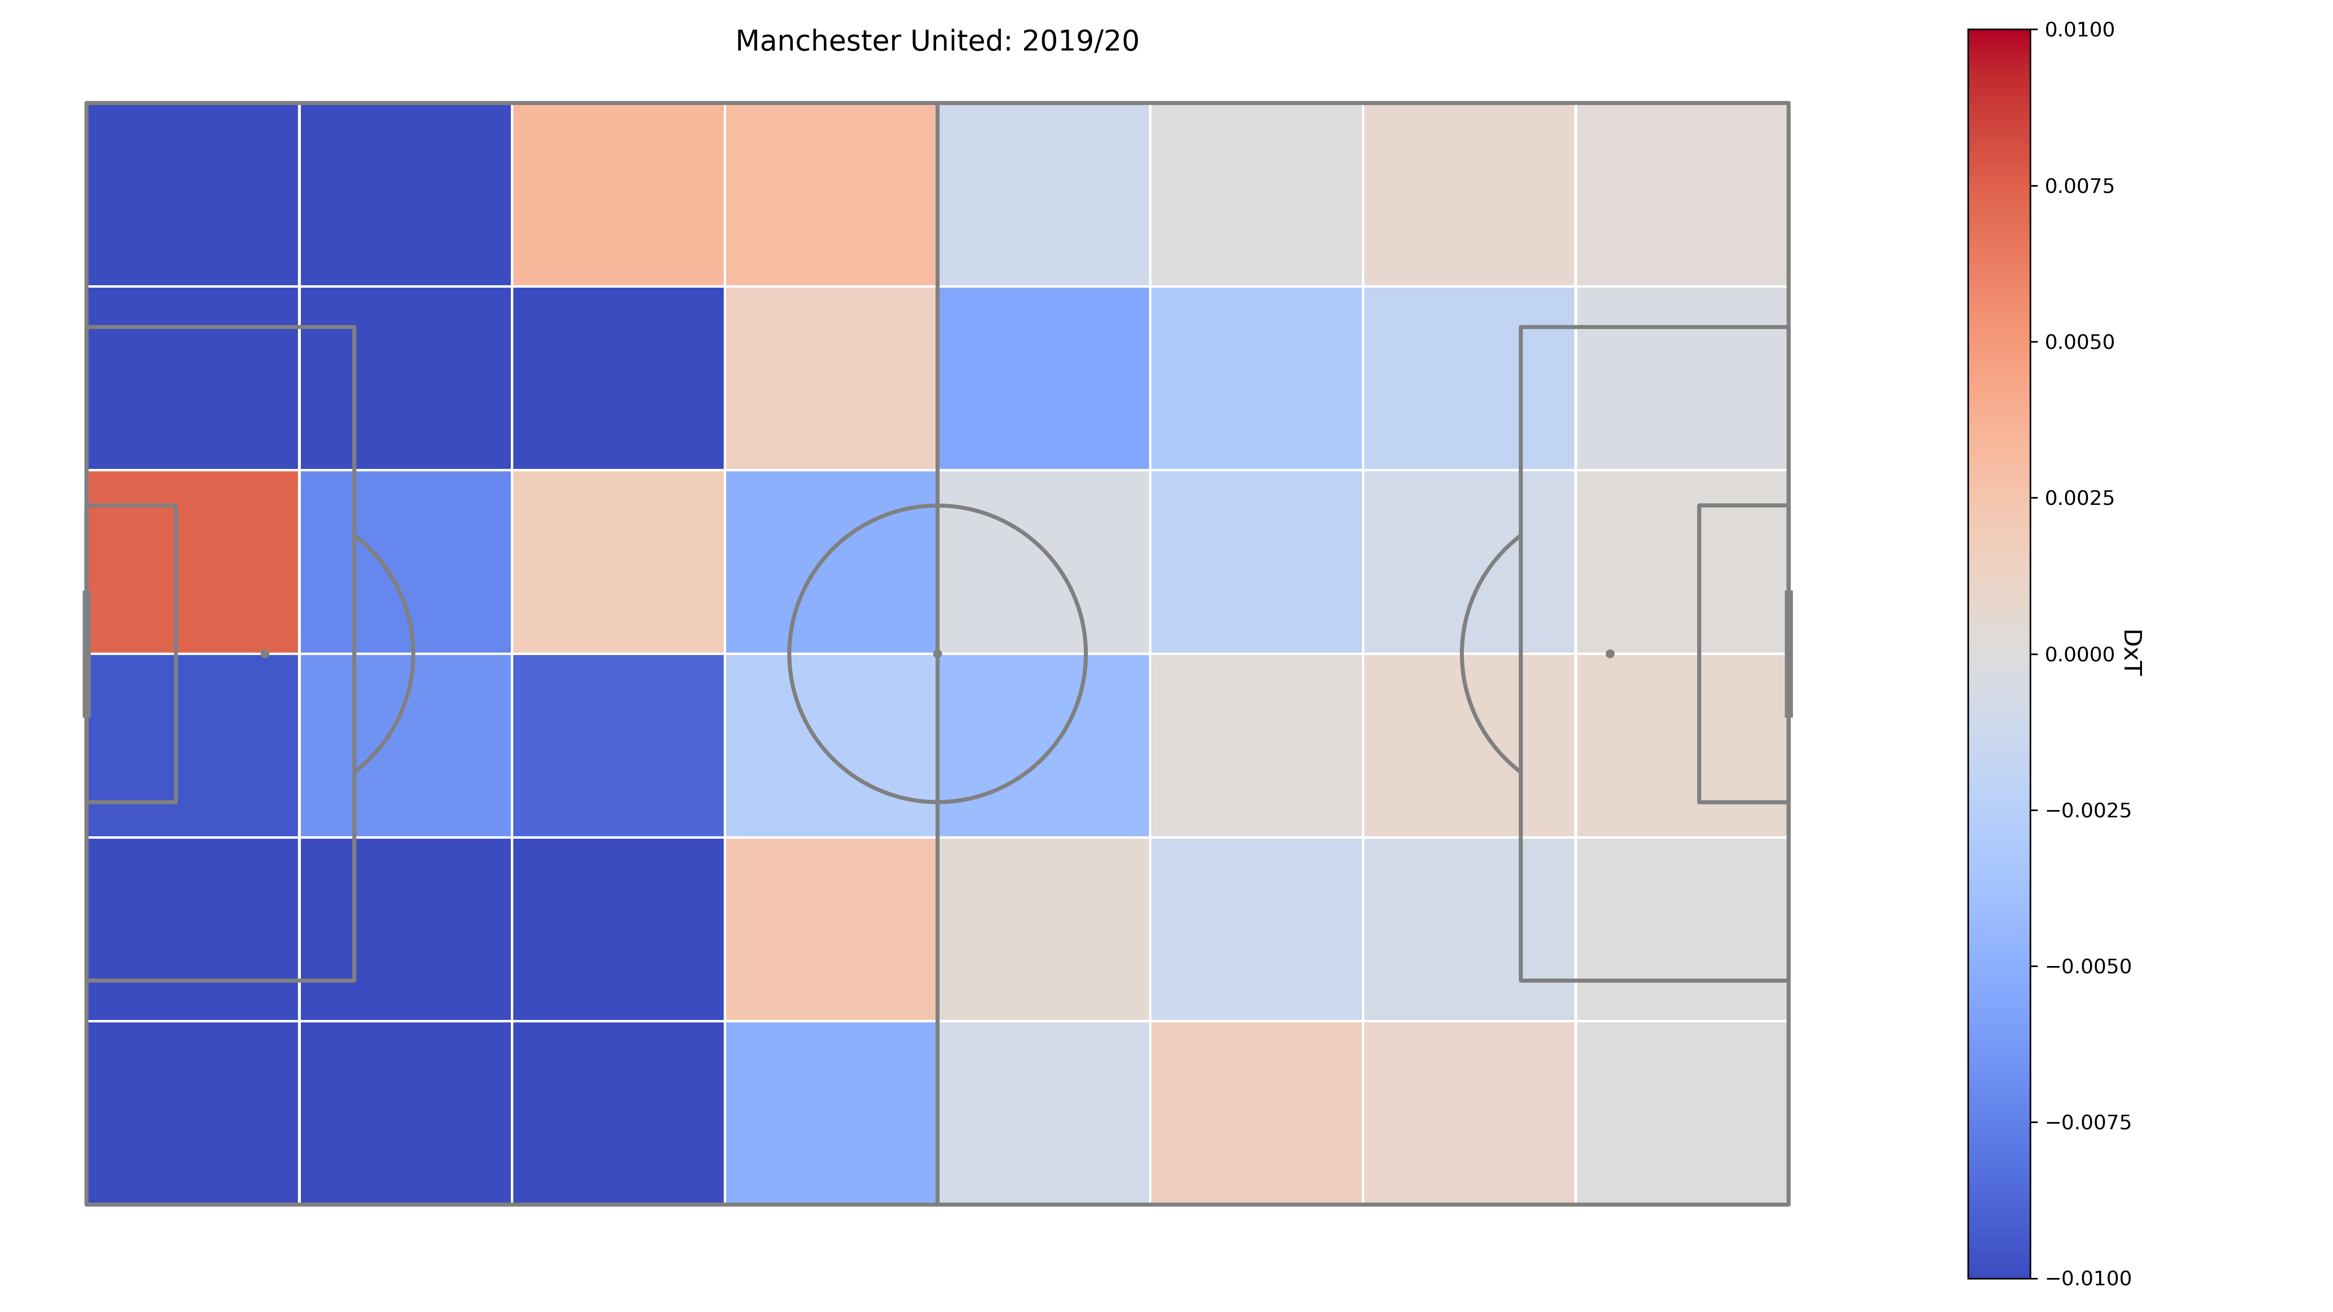
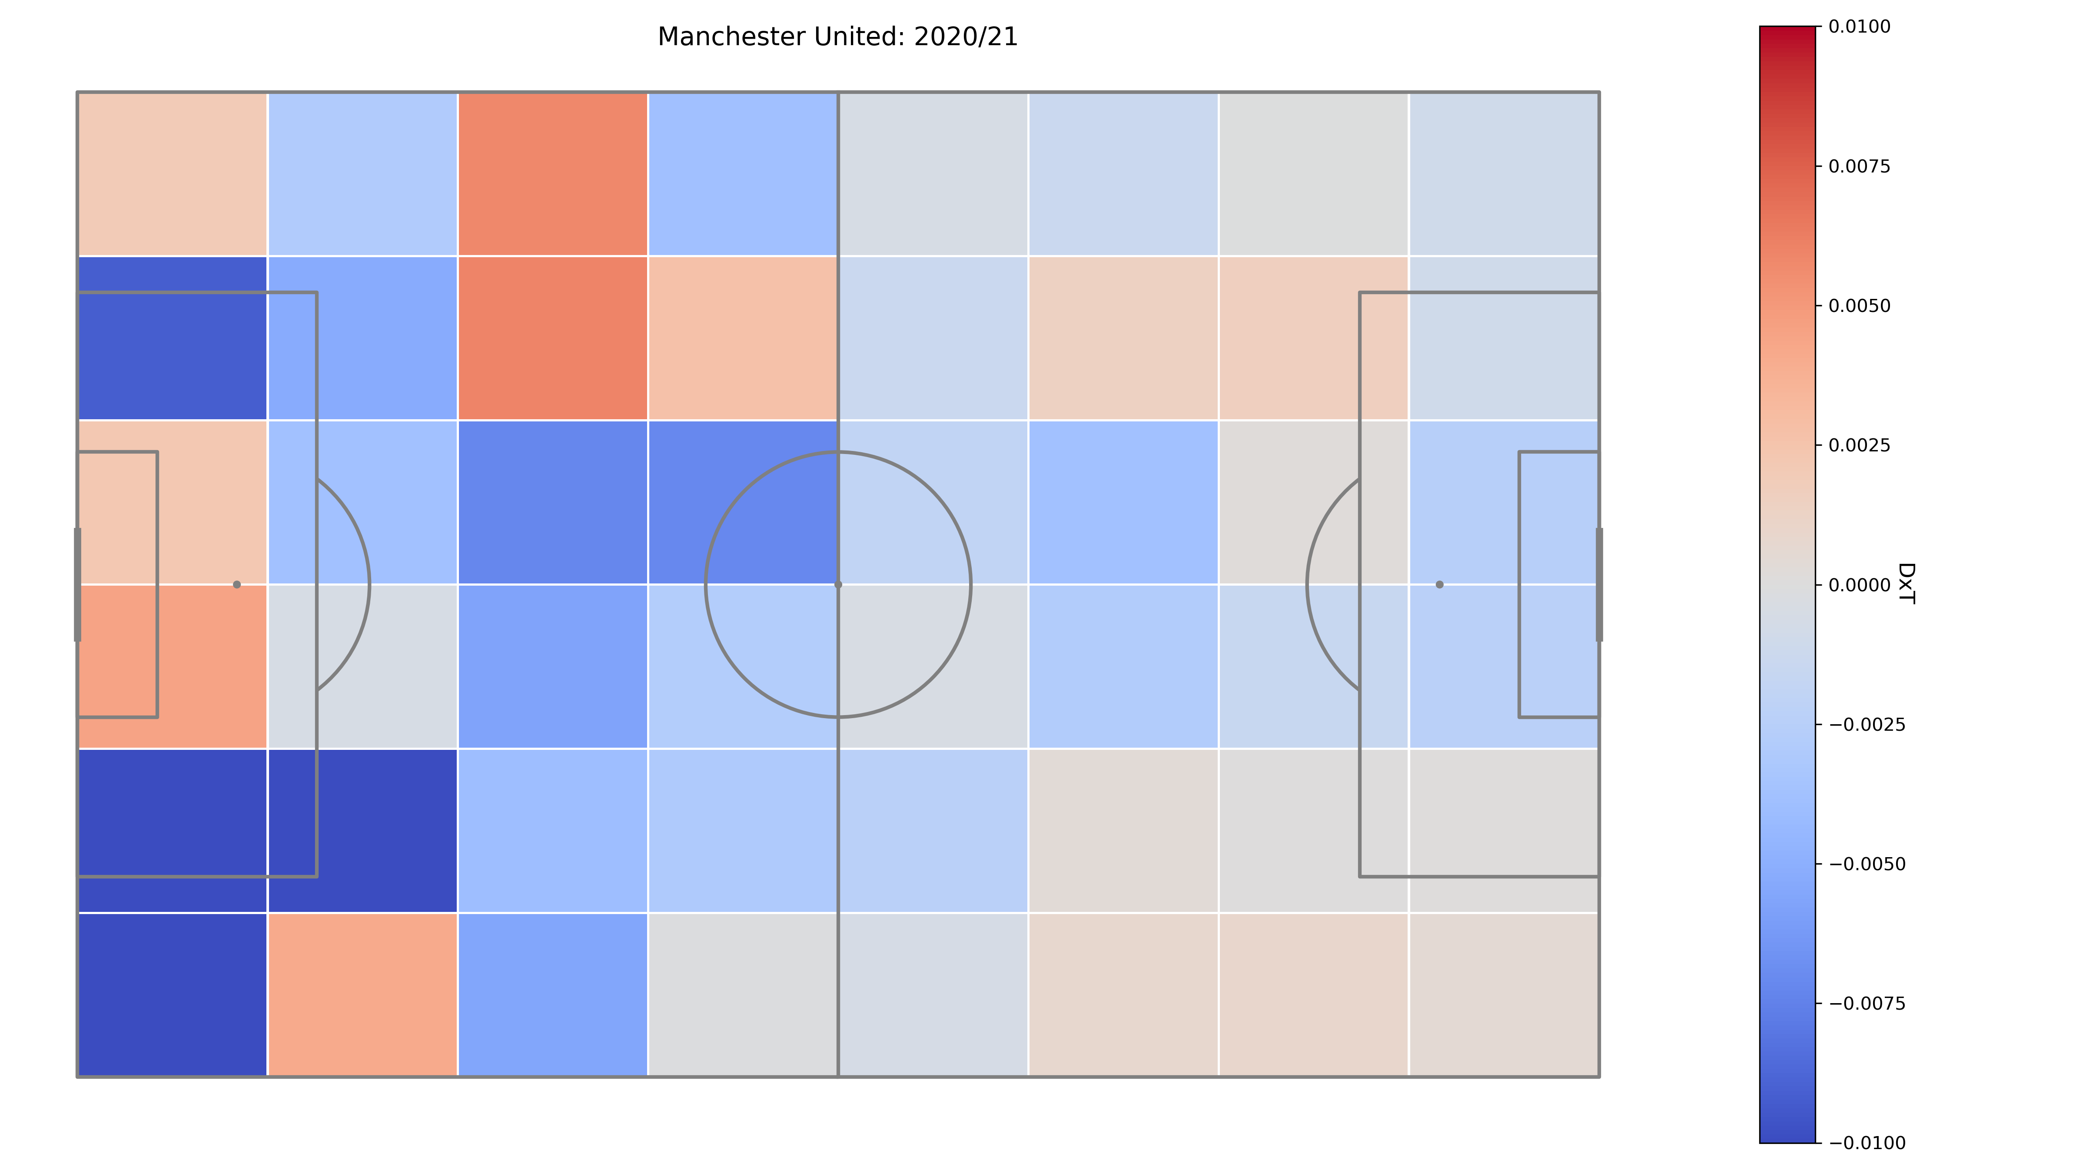
Delta xT
Legendary AC Milan defender Maldini said:
“If I have to make a tackle, I’ve already made a mistake”
On-the-ball events data are blind to off-the-ball context.
Indirectly quantify team defensive strengths and weaknesses via Delta xT:
Mean opponent threat per zone Vs. Man United;
Mean opponent threat per zone excl. Man United;
Mean threat deltas over all 19 opponents in EPL.
2017/18
2018/19
2019/20
2020/21
Notes:
SECOND APPLICATION, LOOK AT AN INNOVATION CALLED DELTA xT
Delta xT is measuring the subtle differences between how opponents deviate from their usual strategy when they’re specifically playing against Manchester United.

Slide 25
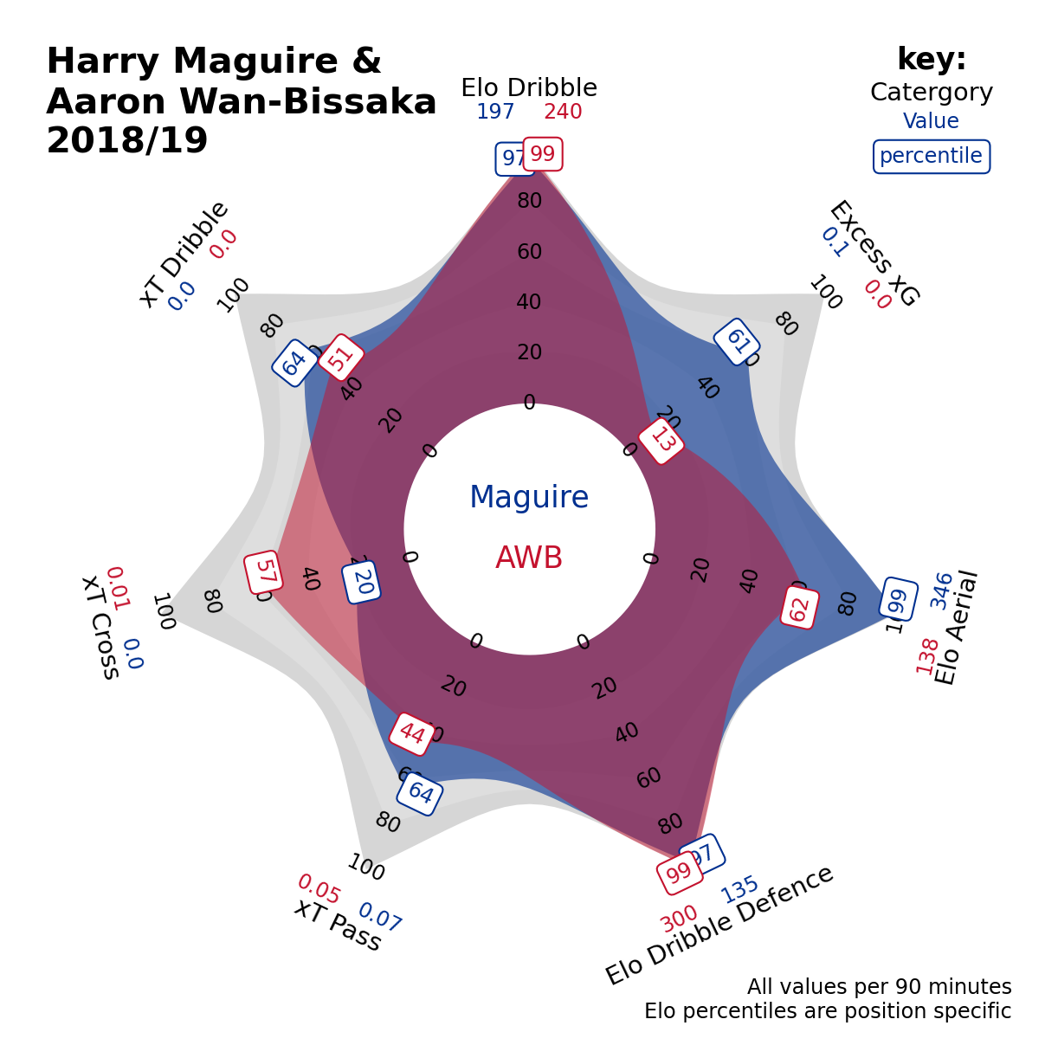
Measuring Maguire & AWB success
2017/18
2018/19
Notes:
ENABLES US TO IDENTIFY WEAKNESSES IN THE TEAM’S DEFENCE: > WE CLEARLY SEE WEAKNESS ACROSS THE ENTIRE DEFENCE PRIOR TO SIGNING MAGUIRE & AWB 2 YEARS AGO
Radar taken the season before both players joined Manchester United show them to be the BEST defenders against the dribble, the BEST at dribbling out of defence, and HARRY MAGUIRE to be the BEST aerial duelist.
Also have complimentary passing and crossing, with Maguire also offering an above average goal threat.

Slide 26
Measuring Maguire & AWB success
2017/18
2019/20
2018/19
2020/21
Notes:
MEASURE THE IMPACT OF THESE SIGNINGS ON THE DEFENCE: OBJECTIVELY JUDGE IT TO BE SUCCESSFUL RECRUITMENT.

Slide 27
Summary
Opta’s data found to be more accurate, complete, spatially precise, and significantly more straightforward to work with than Wyscout data
Introduced framework to value individual player actions called Bayesian Expected Threat
Open-sourced software to keep value surfaces up-to-date as football evolves, integrate any data source, and encode domain expertise
Showcased practical applications for recruitment and matchday use cases

Slide 28
Future work
Integrate different types of football data – optical tracking data and training performance data – to produce more expansive, position-specific radars
Expand geographical coverage beyond the English Premier League to realise the ”Moneyball” ambition of the techniques developed
Apply Elo system to determine relative league strength to support expansion

Slide 29

Appendix

Slide 30
References
H. Eggels, Expected goals in soccer: Explaining match results using preductive analystics. 2016.
R. Noordman, Improving the estimation of outcome probabilities of football matches using in-game information. 2019.
N. Van den Hoek, Improving expected-goals models: Towards more accurate values for individual shots by considering more detailed information. 2019.
Maaike Van Roy et al., Valuing On-the-Ball Actions in Soccer: A Critical Comparison of xT and VAEP. 2019.
K. Singh, Introducing Expected Threat (xT). 2019.
R. Pollard and C. Reep, Measuring the effectiveness of playing strategies at soccer. 1997.
D. Sumpter, Soccermatics: Mathematical Adventures in the Beautiful Game. 2016
D. Sumpter, Twitter thread on synthetic shots. 2020.
I. McHale, P. Scarf and D. Folker, On the Development of a Soccer Player Performance Rating System for the English Premier League. 2012.

Slide 31

Paired xT
Straightforward to determine the recipient an action that moves the ball.
Identify key partnerships between players by looking at pairs with high concentrations of their team’s overall xT.
Use cases:
Strategically target partnerships by man-marking on or both players or look to cut the supply between pair.
Positions of fragility within Man United squad.
Notes:
Second application is an extension of Player xT: looking at Paired xT.

Slide 32
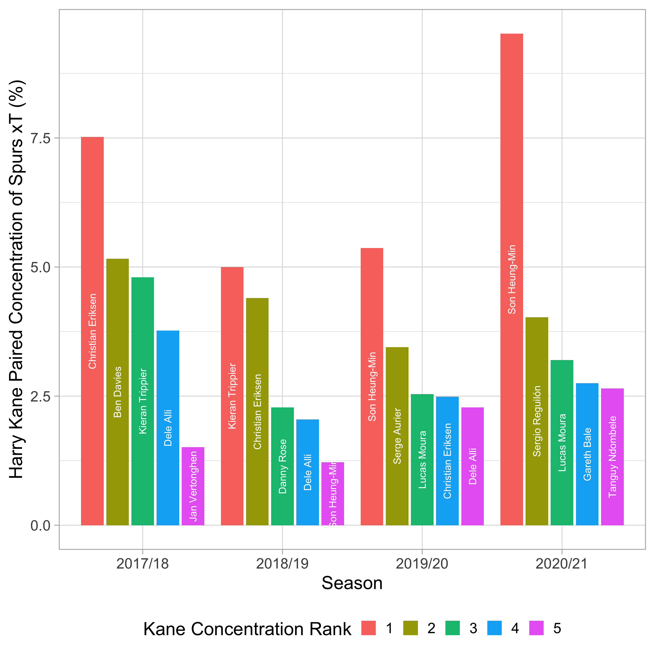
Paired xT: Concentration
Notes:
Tottenham’s Harry Kane is frequently involved in pairs whose concentration ranks highest in the entire Premier League:
The fan interpretation of this is that Spurs are often seen as a two-man team.
In 2017/18

Slide 33
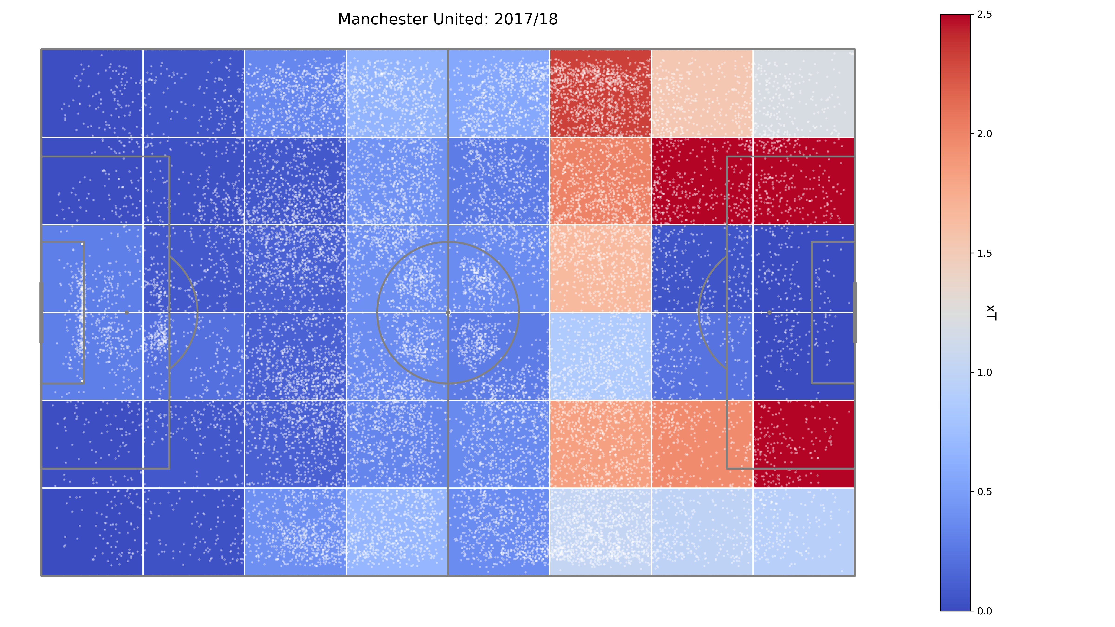
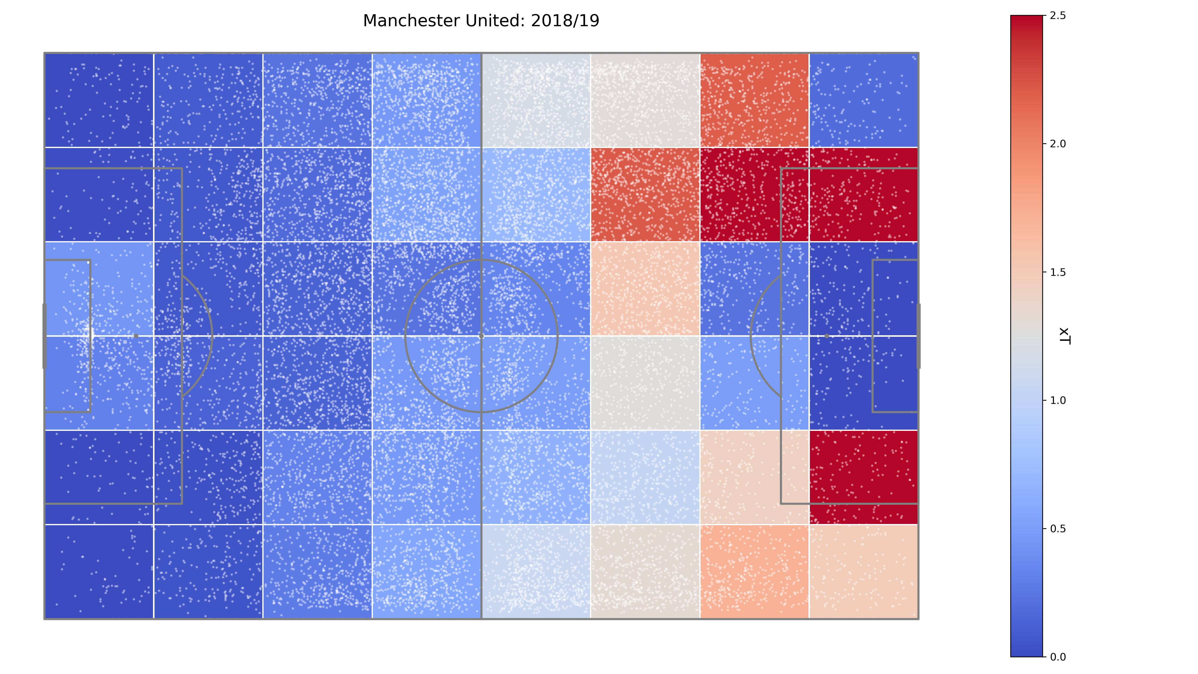
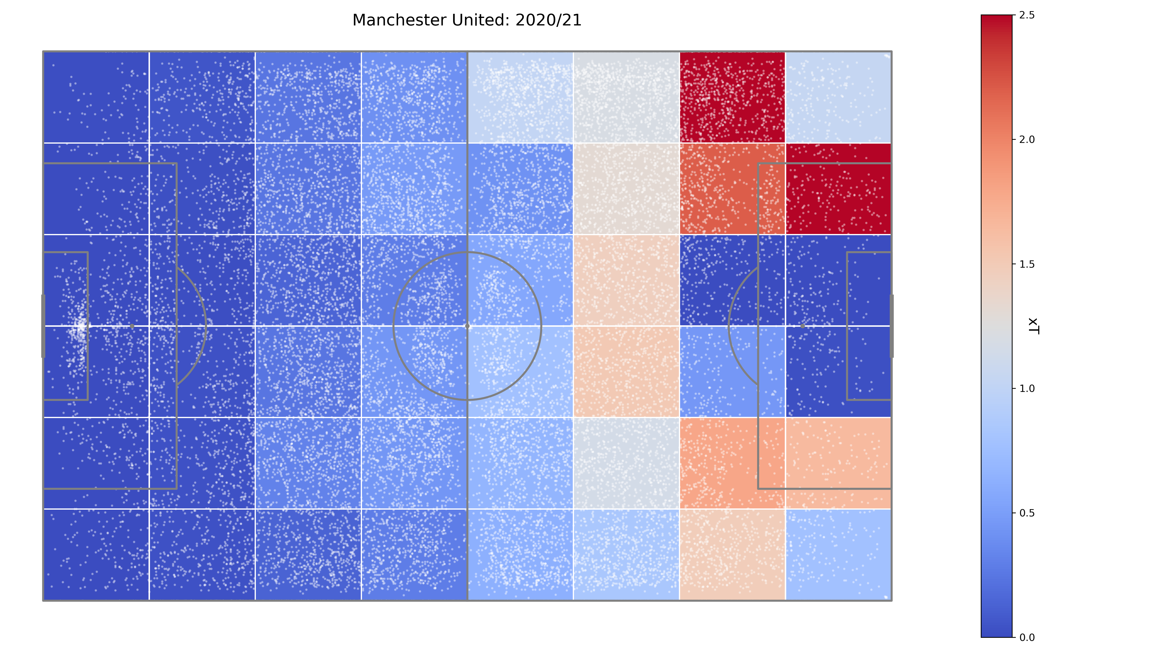
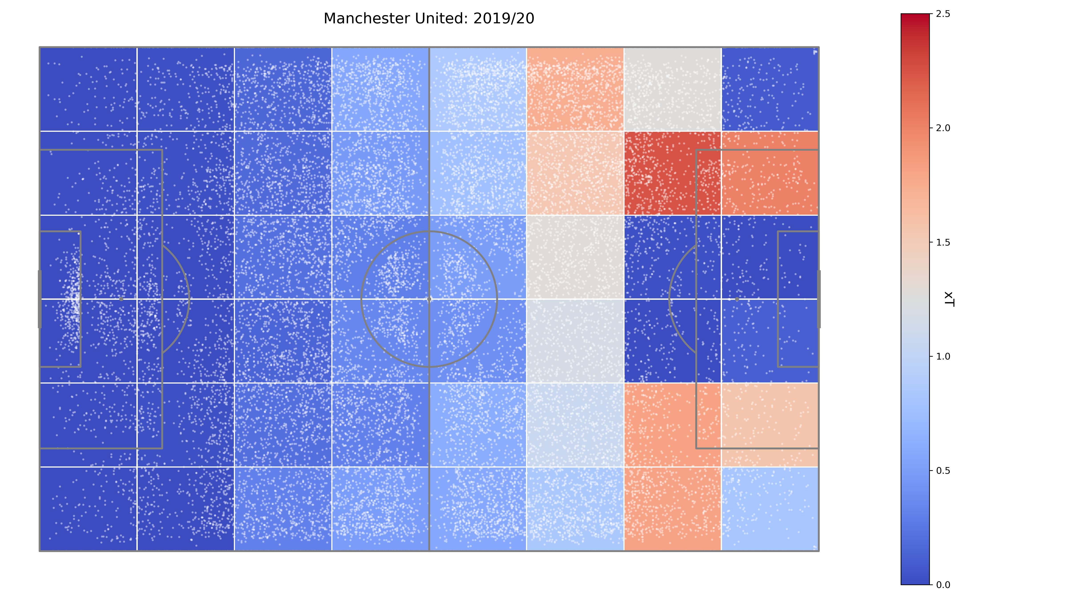
Team xT
Aggregate xT values per team per season, highlighting strategically focused threat.
Man United signature to build attacks in wide areas – core tenet of Sir Alex’s success.
Becoming increasingly dependent and predictable on left wing threat.
Marcus Rashford (LW) played almost every minute of 2020/21, whilst minutes were shared between Greenwood (RW) and James (RW) on opposite flank.
2017/18
2018/19
2019/20
2020/21

Slide 34
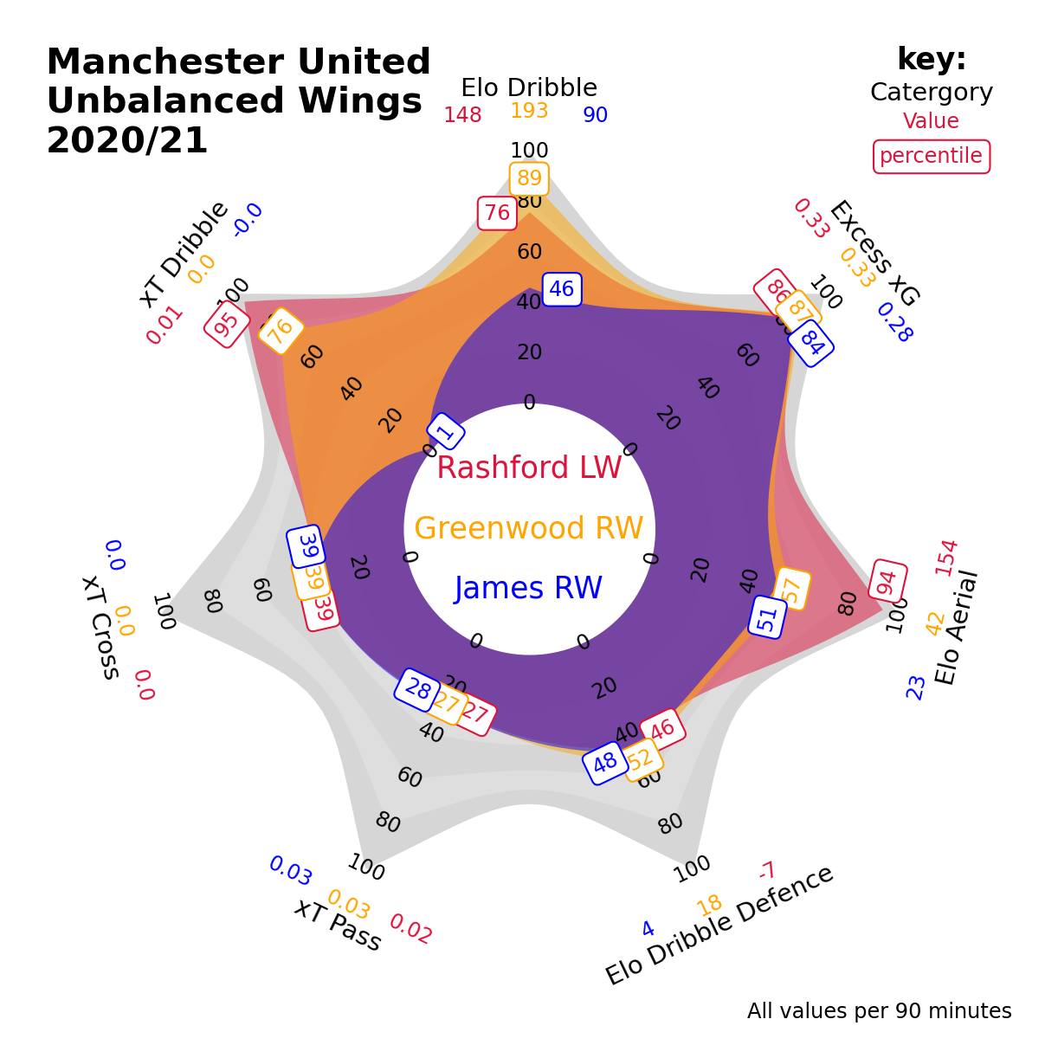
Team xT
Rashford and Greenwood exceptional dribblers and finishers, with Rashford also brilliant in the air.
Team’s aggregate weakness on the left-wing caused by James’ abysmal dribbling.
Recommend renewing interest in previously scouted Sancho, selling James, and looking for Rashford backup.

Slide 35
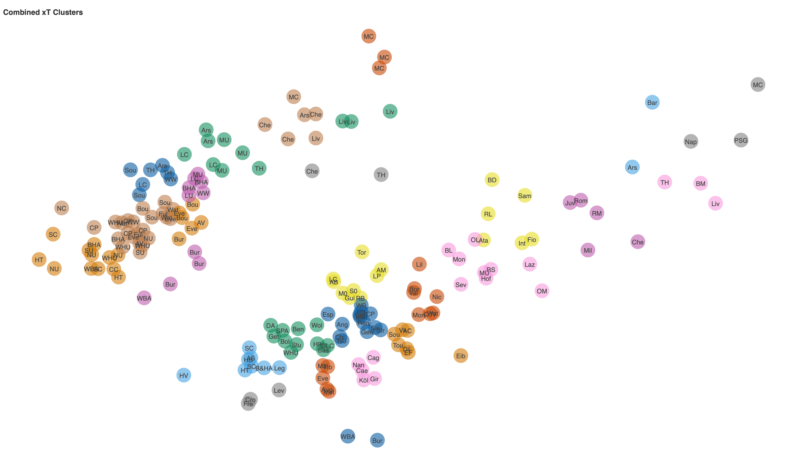
Team similarity clustering

Slide 36
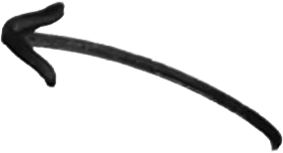

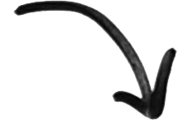
Team similarity clustering
Opta
Wyscout

Slide 37
Opta Vs Wyscout: Summary
Opta’s data found to be more accurate, complete, spatially precise and significantly more straightforward to work with.
Wyscout’s data contained two detrimental sources of bias:
Look-ahead bias stemming from deflected shots being disproportionately omitted from the dataset;
Main denominator used to normalise metrics biased low by unknown amount.
Opta data was almost exclusively used for following modelling and applications unless explicitly specified.
Notes:
Move = dribble, cross, pass.

